Slide 1
Oceanography and Geographic Information Systems (GIS)
Notes:
Hello,
My name is Michael Carron. I am the Chief Scientist at the Northern Gulf Institute. My office is located at NASA’s Stennis Space Center and I am a research professor at Mississippi State University. Welcome to a lecture on Oceanography and Geographic Information Systems. In this lecture I will give you an overview of Oceanography and Geographic Information Systems, what we call GIS. I will show you some examples of GIS that you will recognize from your daily lives and then show you some examples of how oceanographers use GIS which is now a vital tool in their research arsenal.
Oceanography (also called oceanology or marine science) is the exploration and study of the Earth’s oceans, seas, lakes, bays, coastal areas and the processes that effect them. Oceanography is subdivided into many different branches, including marine biology, physics (fluid dynamics, ocean currents, waves), the geology of the sea floor and coastline, chemistry, and marine meteorology among others.

Slide 2
What is “GIS”?
Notes:
A geographic information system (GIS) most of the time integrates hardware, software, and data for capturing, managing, analyzing, and displaying all forms of information referenced to its position on Earth (it can also be referenced to its height above or below the Earth’s surface. A road map is a simple example of geographic or geospatial data, showing the relationship of cities, roads and highways to the Earth. I
In a few moments I will show you geospatial information on the Earth’s surface and some taken below the surface to illustrate what I mean.
You all recognize this image from a very popular Internet-based Geographical Information System, Google Earth. If you haven’t played with this, you students have. If you could look at this image very closely you would see that it is actually made up of very small points of color and brightness . We call each of the points pixels. Your television also displays its images by changing the color of millions of very small points or pixels on its screen faster than our eye can see the changes.

Slide 3
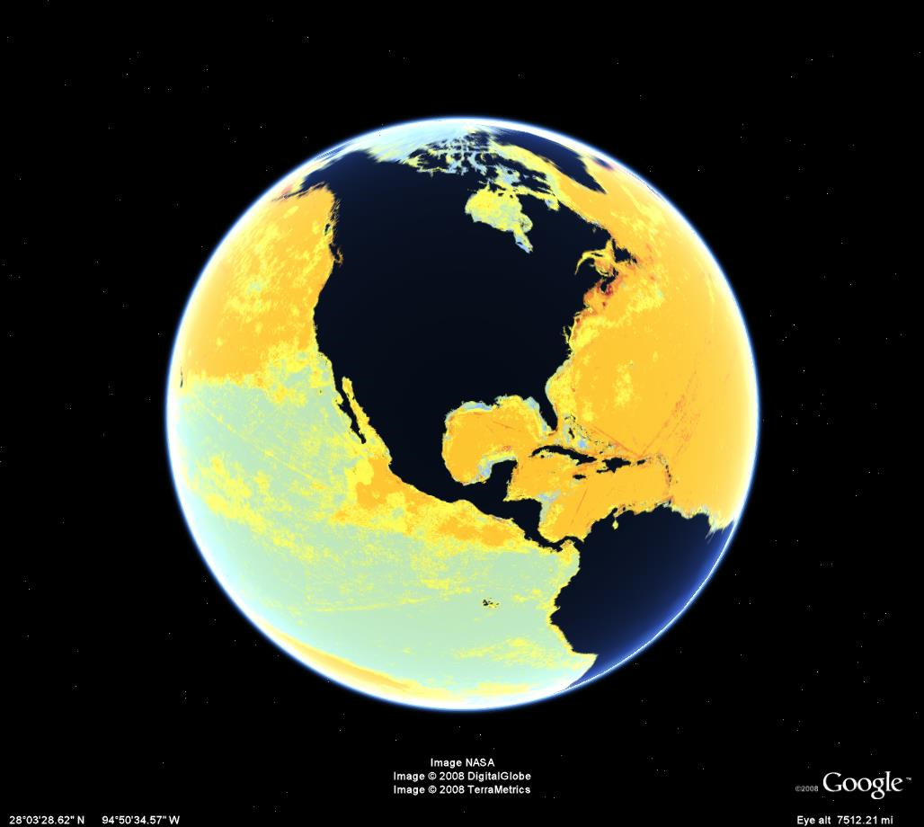
Notes:
There is no reason why we can’t change the color of the pixels in the previous figure to represent something else besides the natural color. In this case the colors on this globe represent an estimate of human impact on marine ecosystems. The scientists who built this used the same Google Earth representation to illustrate their model of human impacts. The green/blue pixels represent relatively low impact and the yellow/orange/red pixels represent progressively higher impacts.

Slide 4
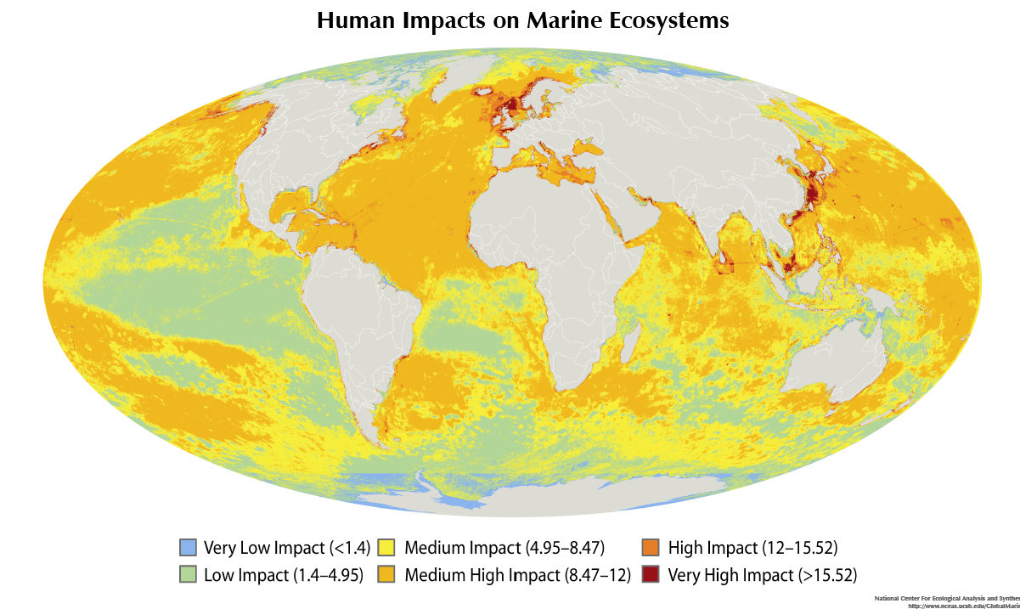
Notes:
This is the way that the authors of the Human Impacts study showed their results for the whole world. They had their GIS show the whole world on a flat sheet. This type of depiction is called a Mollweide Projection. Sophisticated GIS systems give the user many different options to present the results.

Slide 5
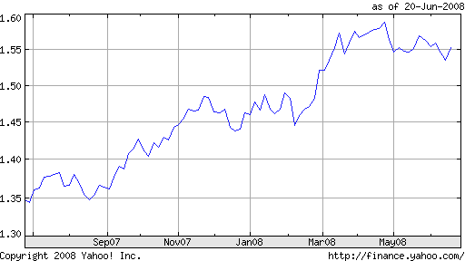
Are there non-georeferenced data?
Value of Euro in US Dollars
Notes:
There are certain data types that don’t require the knowledge of where they were taken. For example:
The average temperature of a human (98.6 degree Fahrenheit or 37 degrees Celsius)
The distribution of education levels by age
The number of eggs carried by a female Blue Crab
The amount of Ice in the Arctic Ocean
And lots more!!
Can you think of some more. I assure you there are millions. How about the number of yeast cells in a kilogram of Swiss cheese? The number of atoms in a kilogram of gold. The value of the US Dollar against the Euro (this doesn’t change in space, but does change over time) and the amount of ice in the Arctic Ocean. These last two cases are illustrated here.

Slide 6
What is geospatial information?
Notes:
What is geospatial or georeferenced information or data.
Some property or information located in a physical space, most often in relationship to the surface of the Earth (but not always). Often times we give the position on the surface of the Earth as latitude (position up or down from the Equator) and longitude (position to the left (west) or right (east) of a line drawn from the North Pole to the South Pole and running through Greenwich, England. Oceanographers think of these as X, Y, and Z. Z is what ever the value is at the X and Y location.
In general, if you think that you could locate some information on a map then it is geospatial information or data.
A paper map is a simple geographic information depiction, but it really isn’t a system. At one time or another you have all used one of these. The only difference is that you cannot interact with a paper map and change the information shown. In a modern GIS the user can select whatever data she want to display, assuming someone has gone to the trouble of putting the data into the computer system.

Slide 7
Notes:
If you get a map from the internet (Yahoo Maps in this example) or Google Maps you can even have the roads which are geographic data plotted on top of a satellite photo which is also geospatial data. On this depiction we show a satellite image, roads, the names of some roads, a golf course, and the names of some water bodies. What else could we put on this map that would be interesting information? How about hospitals? Is a hospital something that can be georeferenced? Ask yourself, “Is this information something that is located at a specific place on the Earth?” If the answer is “yes,” then information about it (its location and properties) is geospatial data and can be put on our GIS depiction and manipulated in many different ways.

Slide 8
Notes:
Another great example of a GIS that you often see is the weather radar either on the news or on the Weather Channel’s web page. What are all the information items seen here? In the case of the Weather Channel’s web page, shown here, you can zoom in to your own street scale and predict whether a storm cell will hit you. By looking at a series of depictions in a sequence you can even estimate the speed of movement of each of the little storms. The web-based GIS used by the Weather Channel automatically will do this for you with the click of your mouse.

Slide 9
Notes:
If you are using a web-based weather radar map you can also select a satellite photo background since the photo and weather radar are both georeferenced. Notice that the city names and a few main highways are also shown on the depiction. Sophisticated GIS systems can show more information as one zooms in. It wouldn’t do much good to show every road at the scale shown here.

Slide 10
Notes:
Another more sophisticated GIS is the GPS device we are beginning to see in many vehicles. Do you know what GPS stands for? The “G” means “Global,” the “PS” means positioning system. This system uses a group of satellites to locate its position in relation to the Earth. It then plots its position on a map with street names stored in its computer memory. Often times the GPS receiver in an automobile has the location of hospitals, restaurants, sights of interest, airports and many other pieces of information (data) that can be located on its internal map.

Slide 11
Notes:
In a similar way, oceanographers and sailors can locate their boats and ships on a map with water depths and navigation marks on it. We call these “navigation charts.” If the charts are put into a computer system connected to a Global Position System we have a GIS that shows the ships position as the ship moves along.
What other information do you see on this GIS depiction? What area does this chart depict? What are the units of depth?

Slide 12
Notes:
One of the first things studied by oceanographers was the depth of the ocean. In the late-1800s oceanographers (called “hydrographers”) started measuring the depth of the ocean in different places by lowering a line with a weight attached to its end. Since the ocean isn’t the same depth all over, the location (the georeference) was needed. This required the early oceanographers to use stars to locate themselves unless they were close enough to land to use landmarks to navigate. It may have taken them many hours to make one measurement. Once they had lots of measurements they could “plot” them on a blank chart and begin to get a picture of the shape of the bottom. On this chart from 1903 the lines on the chart are lines of equal depth (oceanographers call them “isobaths”).

Slide 13
North
West
East
South
Notes:
Modern GIS systems allow oceanographers to draw a chart that shows the topography (height) of the land (the green and brown part) and the bathymetry (depth) of the bottom of the water (blues and purples). Superimposed on this are the ship tracks where the data were collected.
The arrow points out the Japan Trench, one of the deepest areas of the Pacific Ocean. The GIS used to produce this chart shows a shadow in the trench to illustrate the steepness of the western trench wall. In this case we made the shadow look like the sun was to the west or left of the trench.

Slide 14
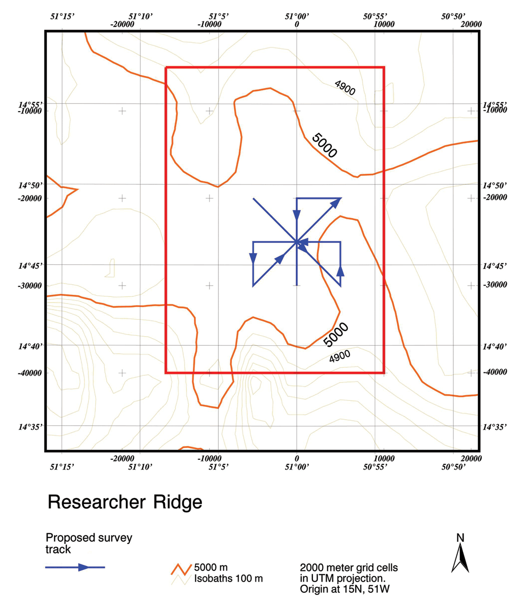
http://www.esri.com/industries/marine/business/ocean_industry.html
Notes:
Oceanographers use charts to plot their ship tracks before they collect data. The blue arrows on this chart show one day’s ship track probably over the top of a undersea mountain. Oceanographers call undersea mountains “Seamounts.”
Remember that I mentioned earlier the latitude and longitude. The light blue lines are the latitude and longitude lines.

Slide 15
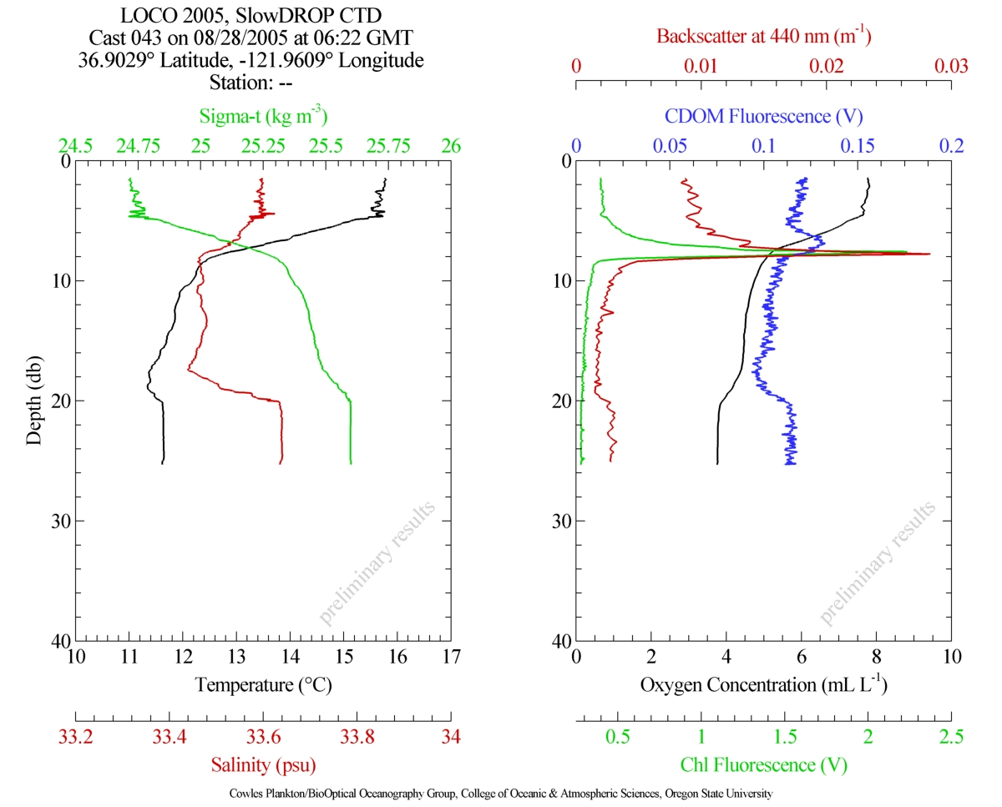
http://argon.coas.oregonstate.edu/biooptics/members/wingard/profile.jpg
Notes:
Oceanographers often collect data at one geographic location. They call one of these a “station.” They collect many different types of data from the surface to the bottom.
These shown here are plots of water density, temperature, salinity (saltiness), acoustic backscatter (echo), oxygen levels (important for animals that don’t breath on the surface), and fluorescence (natural light given off by marine organisms) plotted against the depth of water.

Slide 16
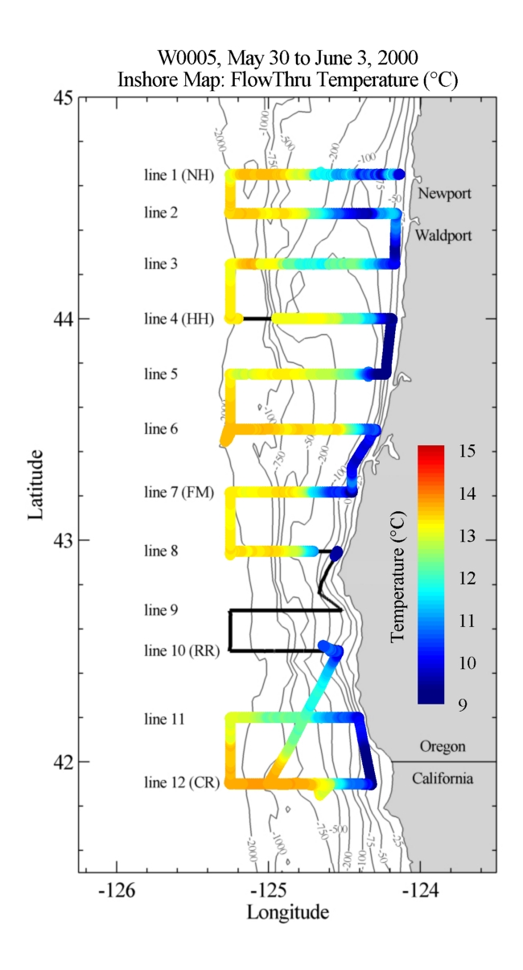
http://argon.coas.oregonstate.edu/biooptics/members/wingard/2D_overlay.jpg
Notes:
Another way oceanographers use GIS in their work is to plot the data on a chart using different colors to represent different values. This is a sample plot of the temperature of the sea water about 6 meters (about 20 feet) below the surface taken during a ship survey off the Oregon coast. One small dot represents the station shown in the previous illustration. The red, orange and yellow colors represent warmer temperatures and the light-blues and dark blues cooler temperatures. You will notice on this chart that the scale shows the temperatures in degrees Celsius. Scientists almost never use the Fahrenheit system that we commonly use in the United States, but the International Celsius system. In this system water freezes at 0 degrees and boils at 100 degrees. Do you think that makes more sense than freezing at 32 degrees and boiling at 212?

Slide 17
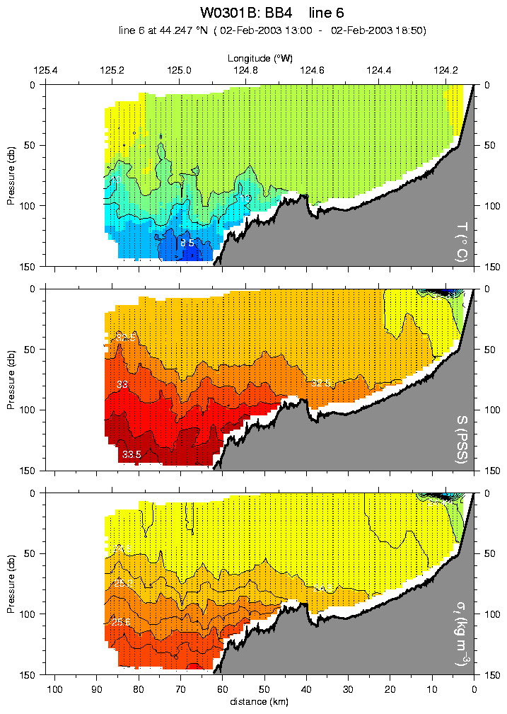
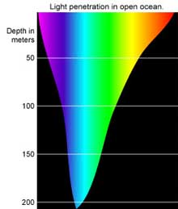
From the National Oceanic and Atmospheric Administration
http://argon.coas.oregonstate.edu/biooptics
Notes:
Another way oceanographers use GIS is to look at a “section” of data. In this case it is similar to the data as show in the last slide, but we are looking a vertical slices of temperature, salinity, the saltiness, and the density. The Oregon coast is to your right and the temperature is shown in colors. The top of the figure is the surface and the bottom is a little over 150 meters deep. Can you find the coldest water in the top section? It’s the little dark-blue patch near the bottom. I’ve pointed it out with a small arrow. Normally, we would expect the warmest water to be on the surface since water expands as it heat up. Three basic properties control the density of water; its temperature, its salinity or saltiness, and the pressure. In almost all cases denser water will be found below less dense water. If the opposite is observed, the less dense water will float up and replace the more dense water near the surface.
Can you figure out how deep 150 meters is in feet? Hint: Multiply by 3.28. 150 meters is a little less than 500 feet. The deepest part of the ocean is in the Pacific Ocean and it is almost 11,000 meters (about 36,000 feet) deep.
Did you know that light only penetrates about 200 meters into the ocean? The figure on the right shows how deep different colors penetrate the ocean. Blues and greens go the deepest. This is why the ocean is blue or blue-green.

Slide 18
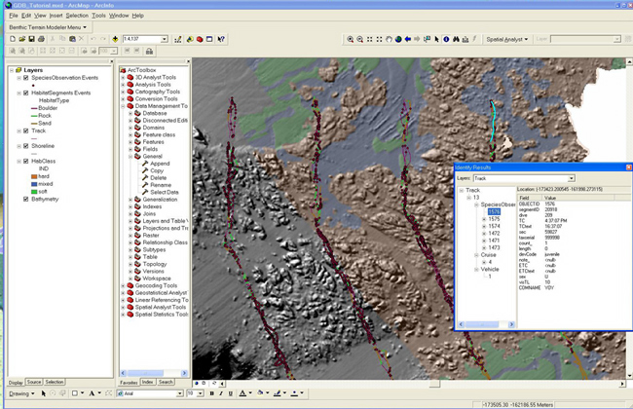
http://dusk2.geo.orst.edu/djl/arcgis/ArcMarine_Tutorial/
Notes:
Modern GIS systems allow oceanographers to almost “see” information about their data sets. Here the different color dots represent the bottom sediment type (rock, sand, or boulder) and the hardness of the bottom is superimposed on top of 3-D looking depiction of the bottom. The different colors (grey, blue, green, etc. represent different hardnesses)

Slide 19
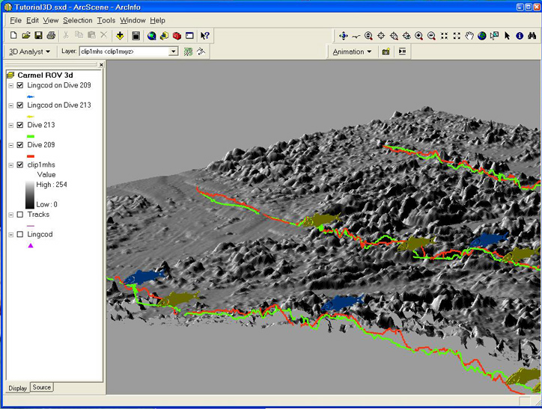
http://dusk2.geo.orst.edu/djl/arcgis/ArcMarine_Tutorial/
Notes:
This depiction shows the tracks in 3-D of different submersible dives and where schools of fish were seen. The fish are the olive and blue figures. Each color shows where the Codfish were seen on the two dives.

Slide 20
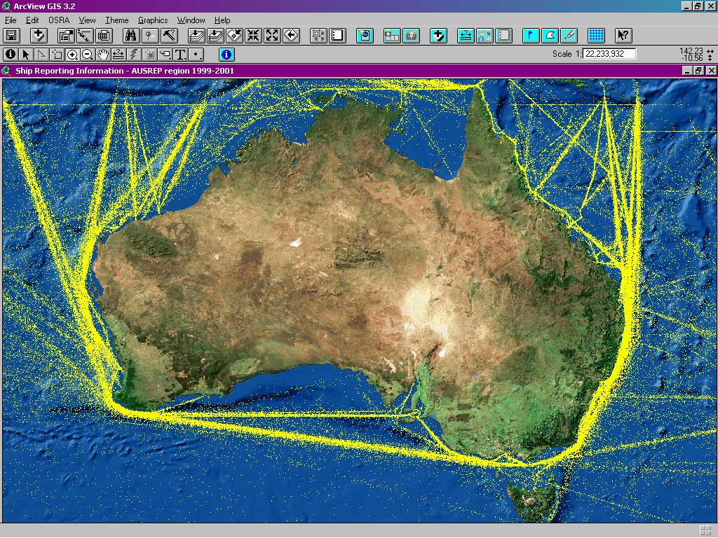
http://www.esri.com/industries/marine/business/ocean_industry.html
Notes:
This example shows ship position data around Australia. From the individual data points we can discern the shipping lanes. Do you know where Tasmania is on this figure? Do ships going from east to west or from west to east go to the north or south of Tasmania? OK, Tasmania is the little island off the southeast coast near the bottom of the figure. Tasmania has some strange animals and plants that are very different from those found in Australia. You might want to ask your students to think of possible reasons for that.

Slide 21
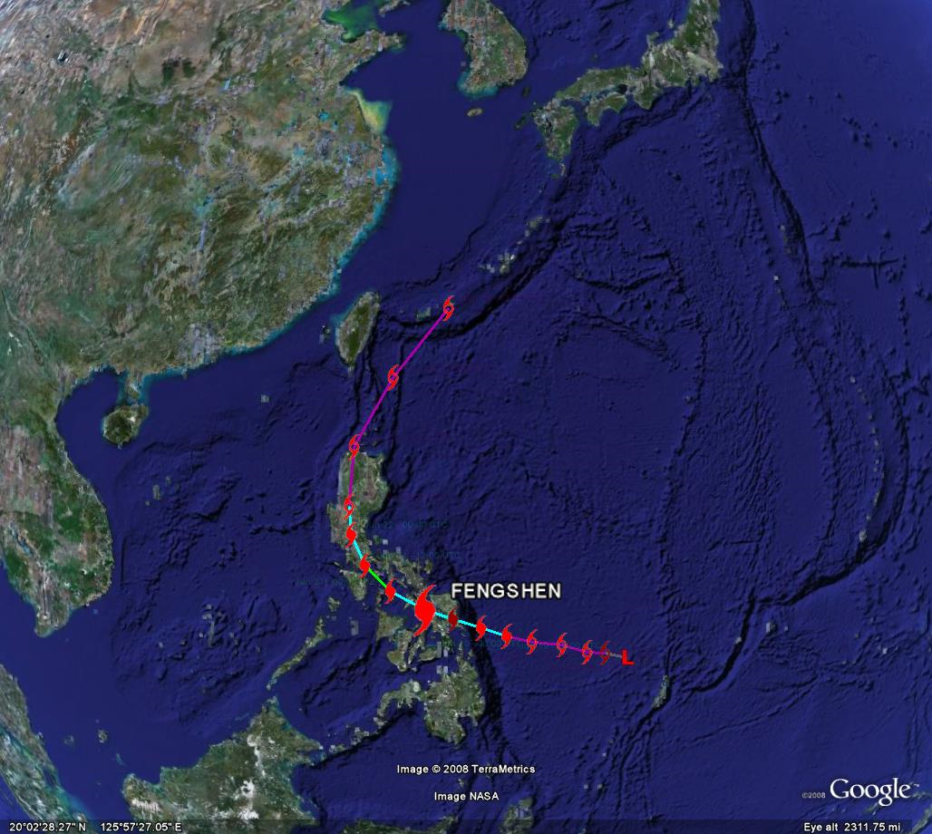
Notes:
Another example of a GIS that should be familiar to you shows a plot of a Typhoon (what we call a “Hurricane”, but located in the western Pacific Ocean). The track of this one is superimposed on top of a depiction of the Earth and the ocean bottom. The GIS used here is the web-based Google Earth.

Slide 22
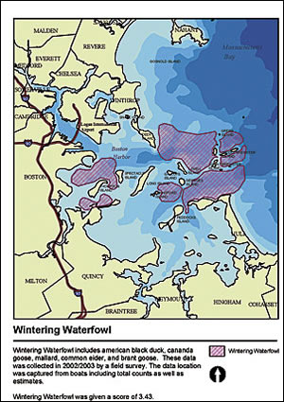
The shaded area indicates gathering areas for wintering waterfowl, such as American black ducks and mallards.
http://www.esri.com/news/arcnews/spring07articles/risks-to-boston-harbor.html
Notes:
Coastal managers use GIS systems to map important information. In this example you see the waterfowl wintering areas in and around Boston Harbor.

Slide 23
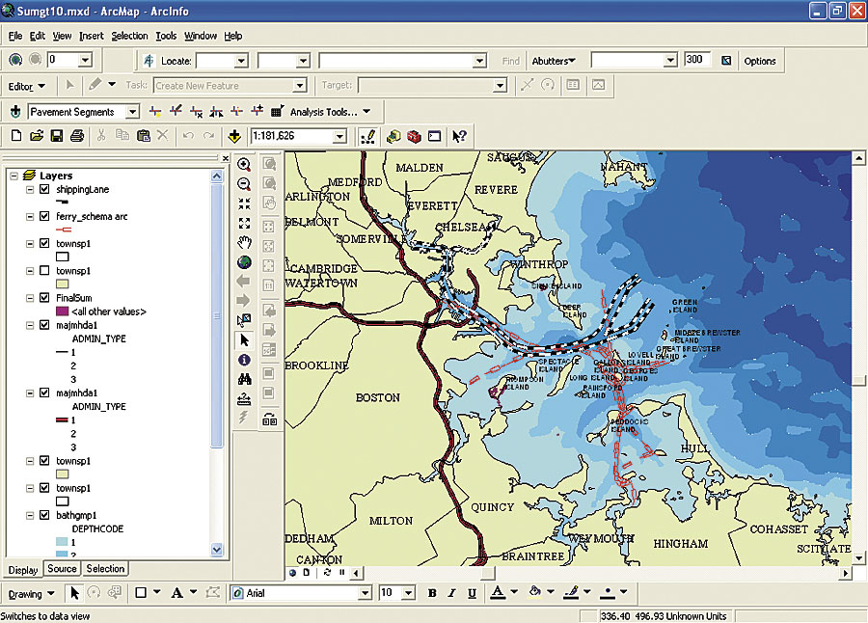
Ferry paths and shipping routes were mapped to better evaluate areas that are vulnerable to increased boat traffic (map sources: USGS, Woods Hole Oceanographic Institute, MassGIS).
http://www.esri.com/news/arcnews/spring07articles/risks-to-boston-harbor.html
Notes:
If a coastal zone manager knows the waterfowl wintering areas in and around Boston Harbor and also knows the ferry paths and shipping routes she could then evaluate which areas are vulnerable to increased boat traffic.

Slide 24
Notes:
The GIS is very valuable to evaluate changes in a property. In this example the red areas represent land loss from 1932 to 2000 and the predicted land loss in yellow from 2000 to 2050 in the Mississippi River delta area. Do you think that the Louisiana legislature, the Corps of Engineers and coastal zone managers find this an interesting chart? What do you think is causing all of the land loss? It might be a fund experiment to ask your students what they think?

Slide 25
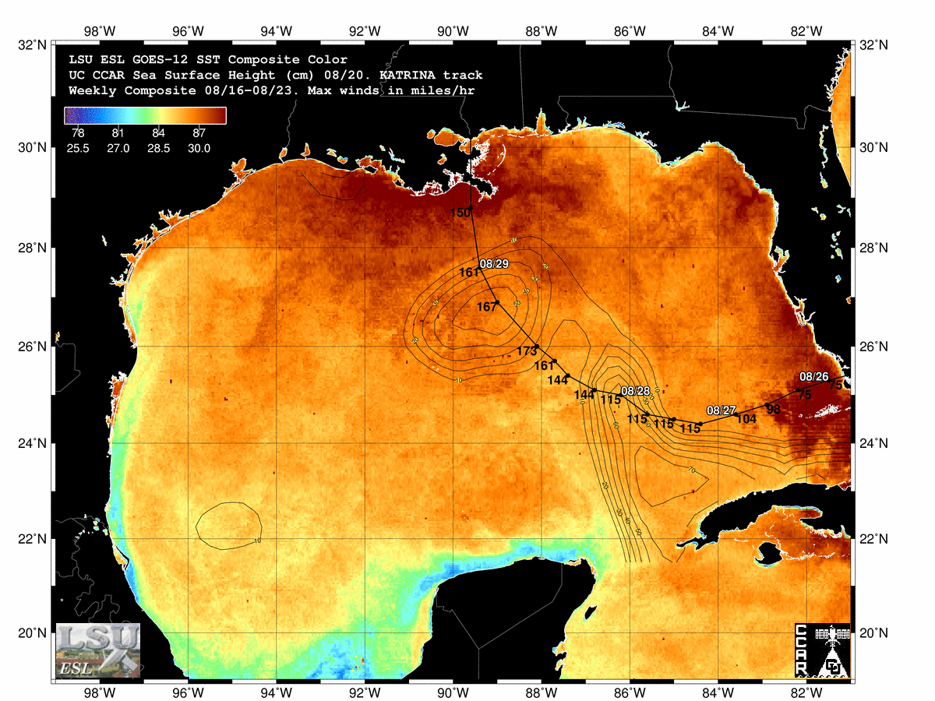
http://www.ngi.lsu.edu/ngi/research/modeling/_images/landloss_delta.pdf
Notes:
This is another interesting GIS depiction. It shows the path and wind speed of Hurricane Katrina in the Gulf of Mexico plotted over a map of sea surface temperature, represented by the colors, and the sea surface height, represented by the closed lines. Both the temperature and sea-surface height were measured by a temperature sensitive camera and a precise altimeter on a satellite. A sea surface height mound, shown by the tip of the arrows, means that there is relatively warmer water below the surface. Why do you think warmer water would cause a mound? Remember, in general, water expands as it warms up. Since hurricanes get their energy from the heat in the ocean, warmer water can cause a hurricane to intensify.
Physical Oceanographers and Marine Meteorologists use GIS to make charts like this to understand the dynamics of hurricanes and to improve their ability to predict the intensity, track and time of landfall of hurricanes. It is estimated that over 2000 people died because of Hurricane Katrina. Do you think people could have been saved if there had been better predictions and warnings?

Slide 26
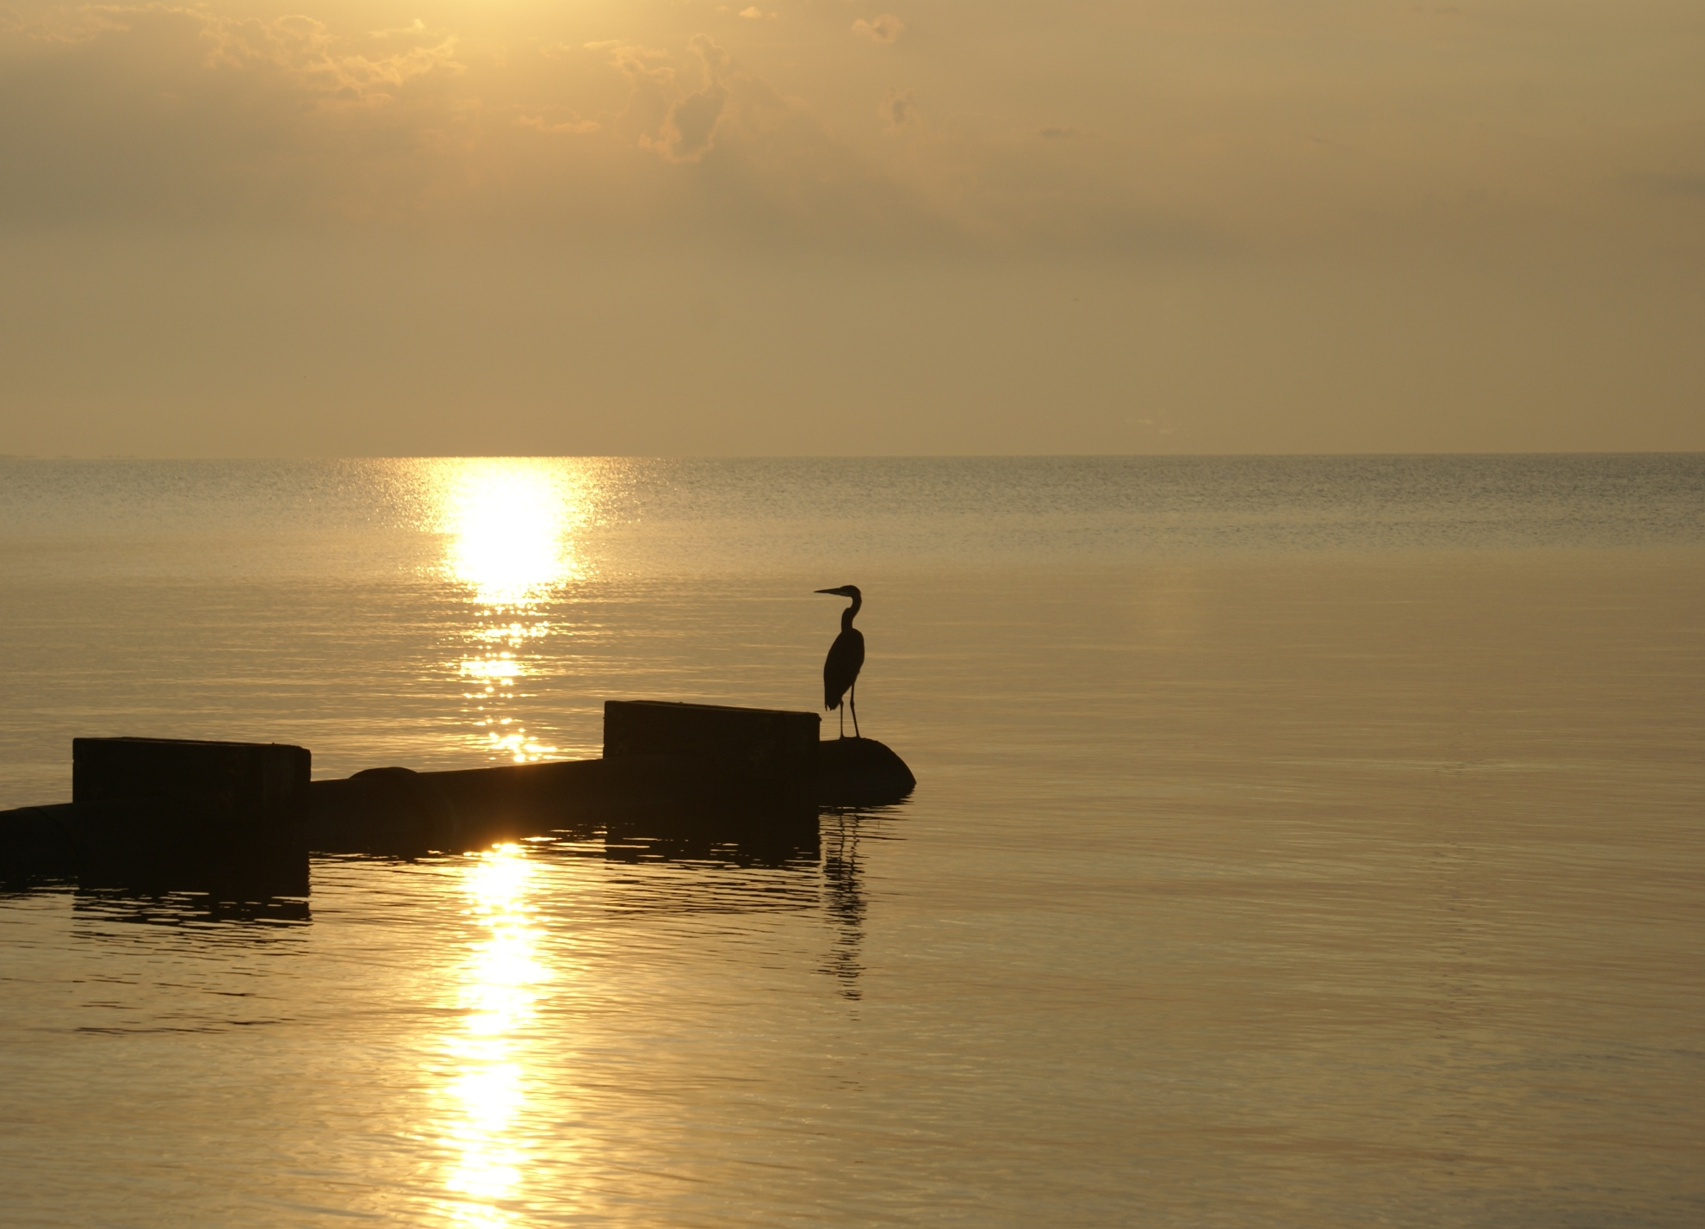
?
Notes:
Geographic Information Systems have become a vital tool, not only for oceanographers , meteorologists and other scientists, but in our daily lives.

