Slide 1
The Importance of Community Involvement in Watershed Monitoring
Examples of Community Involvement in Watershed Monitoring
Regional Watershed Monitoring Programs
Elmer Avenue Neighborhood Retrofit: Community Engagement
Kristy Morris PhD, Senior Scientist
Council for Watershed Health
www.watershedhealth.org

Slide 2
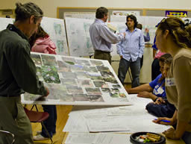
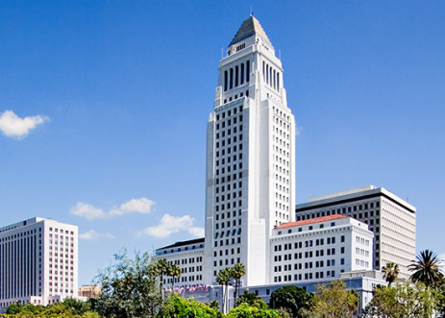
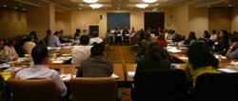
Who We Are:
Working directly with:
Government agencies
Cities and municipalities
Academia
Corporations
Other non-governmental organizations

Slide 3
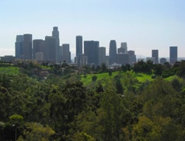
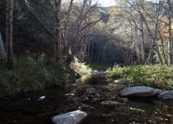
A Vision for 2025: Sustainable Greater Los Angeles
Managing at the watershed scale for economic vitality, social and environmental health
Clean waters
Reliable local water supplies
Restored native habitats
Ample parks & open spaces
Integrated flood protection
Revitalized rivers & communities

Slide 4
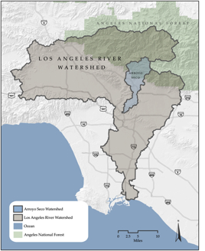
The work we do:
Watershed research and monitoring
Analysis of watershed-related policy
Watershed planning
Education and outreach
Demonstration projects
Technical products & services

Slide 5
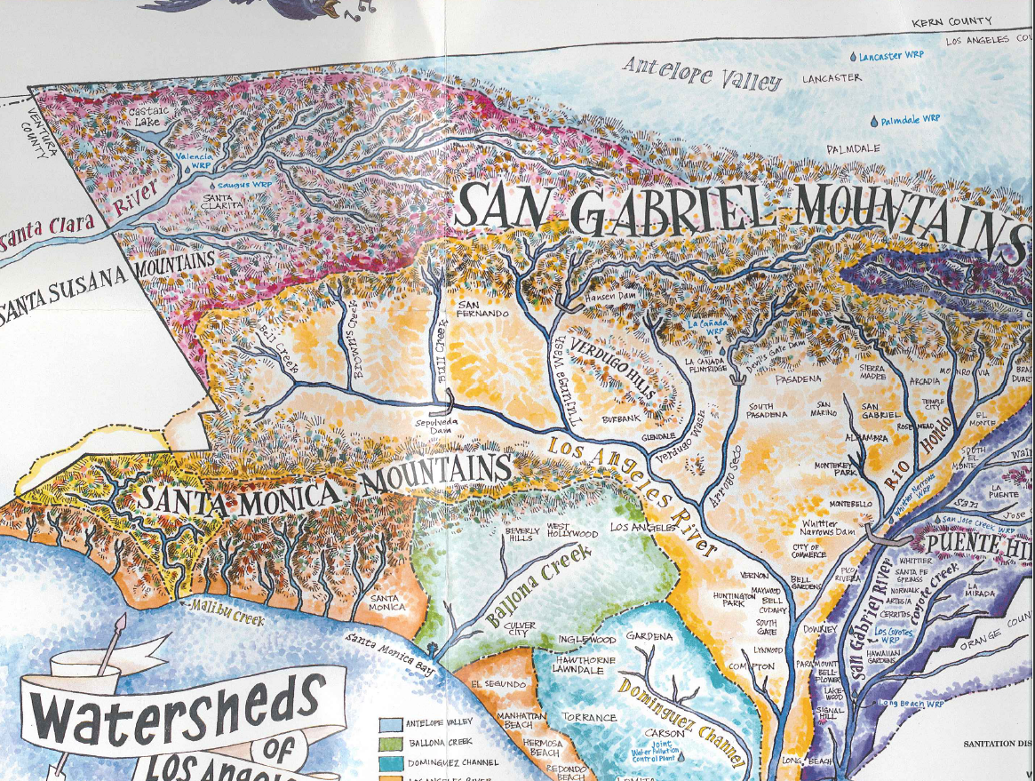

Slide 6
Watershed Monitoring Program Approach
Bring together watershed stakeholders
Compile an inventory of existing effort
Develop list of monitoring questions
Assess current ability to answer questions
Design monitoring program
Notes:
6

Slide 7
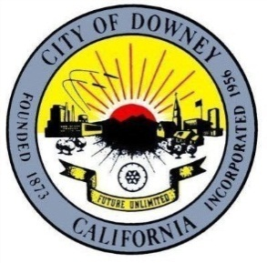
Stakeholders

Slide 8
State of the Watershed .
Monitoring Questions
1.
What is the health of streams ?
2.
How are conditions at areas of unique importance ?
3.
Are regulated discharges meeting WQ objectives ?
4.
Is it safe to eat fish ?
5.
Is it safe to swim?

Slide 9
What is the health of streams ?
Water Chemistry
General Constituents
Toxicity
Physical Habitat
Benthic Algae
Metals
Nutrients
Organics
Indicator Bacteria
Benthic Macroinvertebrates
Bioassessment
Condition?
Surveys: SWAMP and CADF&G
California Rapid Assessment Method (CRAM)
7-day Ceriodaphnia test
Notes:
9

Slide 10
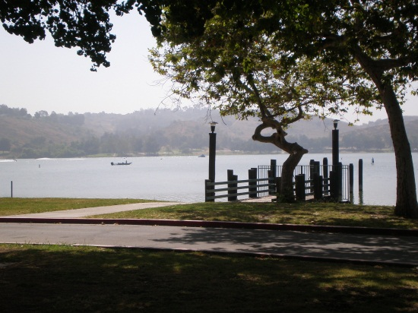
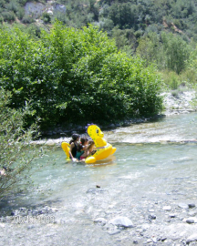
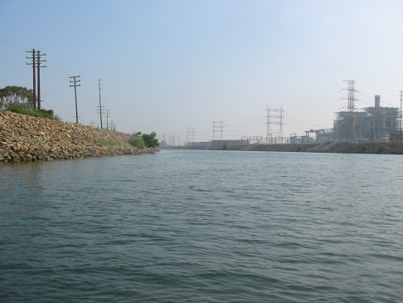
Monitoring Design Qs 2-5
Q 2 Trends at Unique Sites
High use &/or ecological value (CRAM)
Confluence points where tributaries meet mainstem (All indicators)
Pristine sites in upper watershed (CRAM)
Q 3 Meeting Water Quality Objectives
Up and downstream of regulated discharges (chemistry and toxicity)
Bioassessment downstream
Q 4 Safe to eat fish?
Popular fishing sites
resident fish sp.
(Hg, Se, DDT’s & PCBs)
Q5 Safe to swim?
Popular freshwater swimming sites (E.coli)

Slide 11
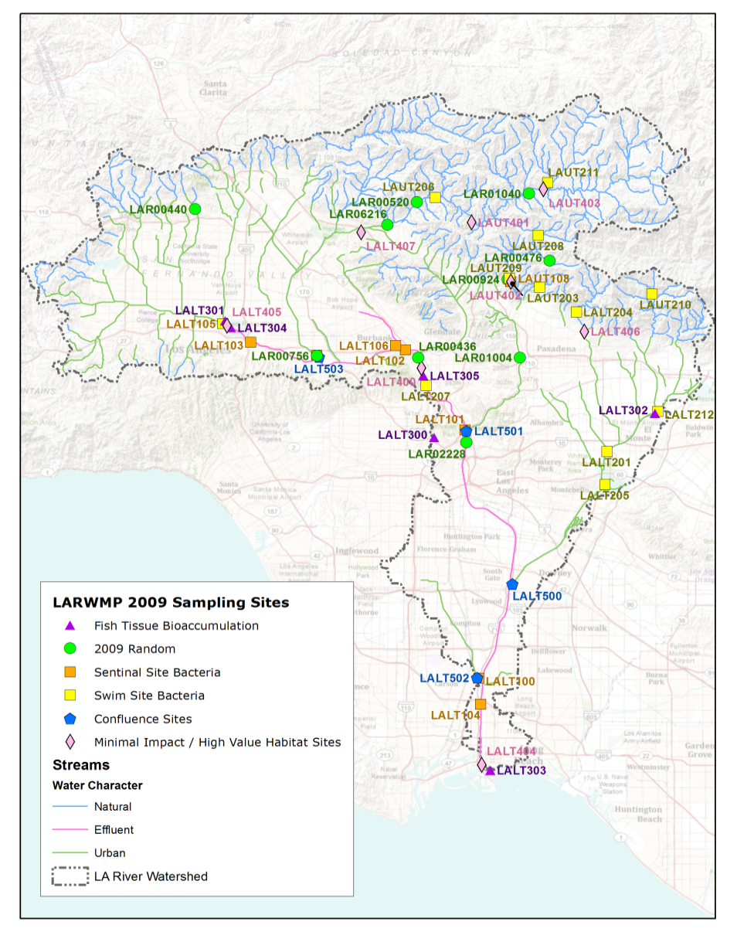
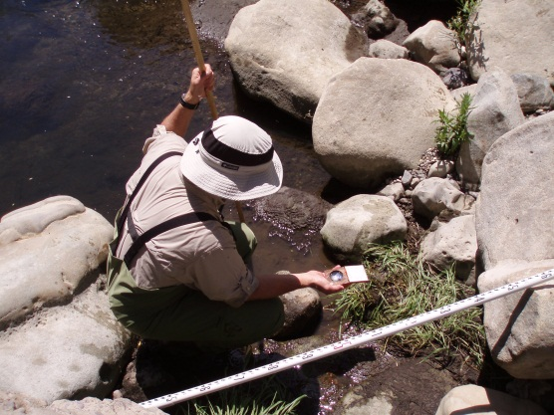
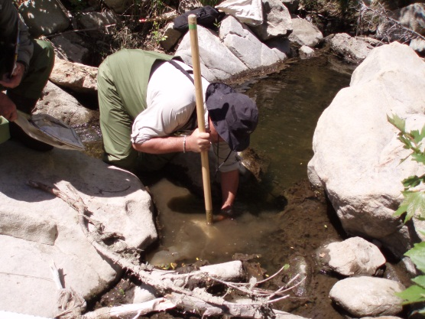
Summary of monitoring activities
LARWMP 2009 Monitoring Sites (Q1-5)
Estimated Number of samples collected
Program | Years | Samples
SGRRMP | 2005-2010 | >515
LARWMP | 2007-2010 | >288
 |  | >803
Many more analyses….

Slide 12
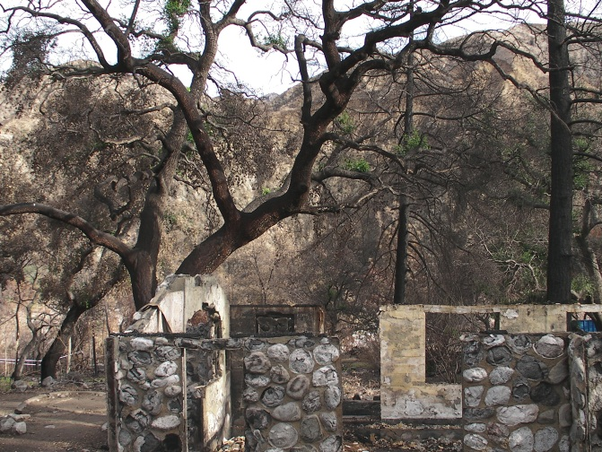
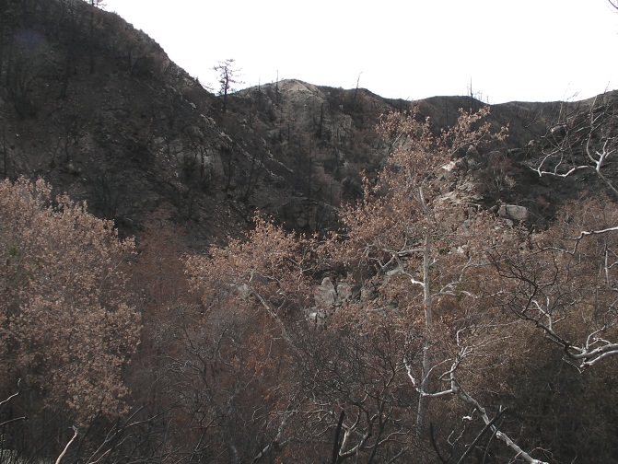
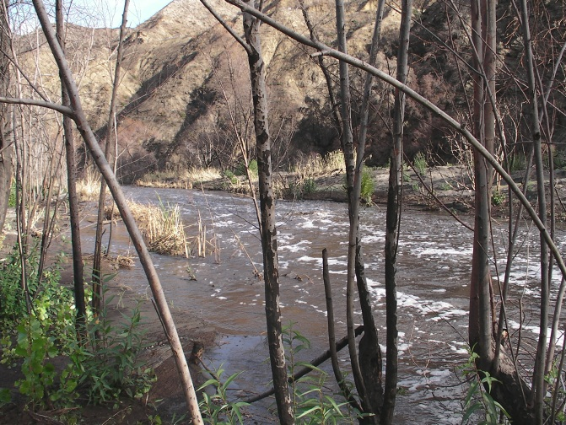
Condition of streams
(Los Angeles and San Gabriel Rivers Watersheds)
Biological communities degraded; mostly in lower watersheds
Very few exceedances of water quality standards
Few toxic endpoints
The biological condition is strongly associated with physical habitat conditions

Slide 13
What can you do?
Volunteer Locally
Heal The Bay-Malibu Stream Team
FOLAR
Surfrider Foundation
Coastkeeper Alliance
Waterkeeper Alliance
Baykeeper Alliance
Santa Monica Baykeeper
Santa Barbara Channelkeeper
Stream Teams
Ventura Stream Team
San Diego Stream Team
Audubon Society

Slide 14
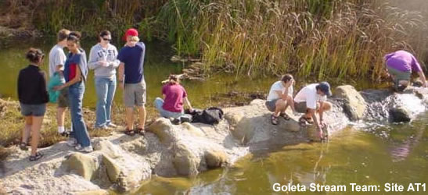
Ventura Stream Team: Informing policy development
Santa Barbara Channelkeeper, Ventura Surfrider foundation + 500 volunteers
6000 volunteer hours in 10 years
Monthly sampling identified excessive nutrients
Image: http://stream-team.org/index.html

Slide 15
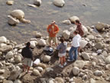
Ventura Stream Team: Informing policy development
Ventura River listed on 303(d) list for algae impairment
Channelkeeper's Stream Team data is being utilized to facilitate development of an Algae TMDL for the River.
Image: http://stream-team.org/index.html

Slide 16
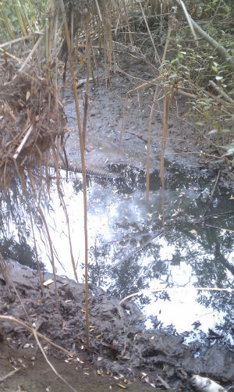
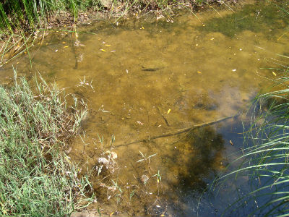
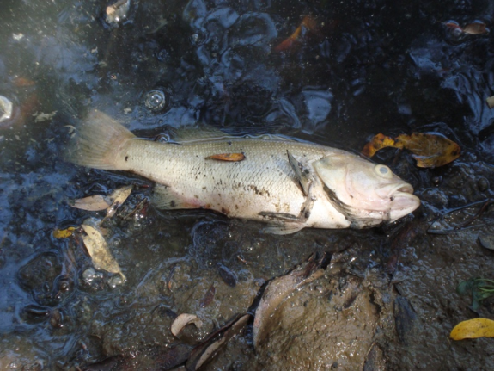
San Diego Coastkeeper: Using baseline data to recognize and Quantify the effects of a sewage spill
Los Penasquitos Creek: Saturday, Sept 10 2011
Downstream
Upstream of spill

Slide 17
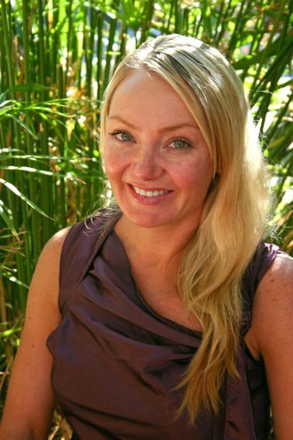
Contact
Kristy Morris, PhD Sr Scientist/ Water Quality
Council for Watershed Health
700 N. Alameda St. Los Angeles, CA 90012
kristy@watershed.org www.watershedhealth.org Ph: 213.229.9960 Fax: 213.229.9952

