Slide 1
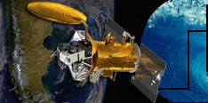
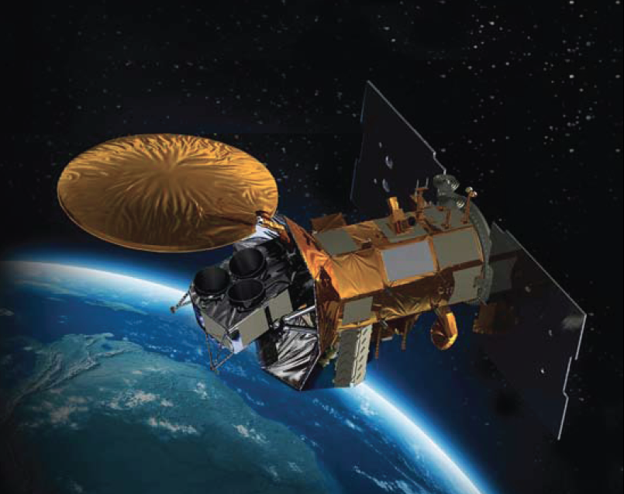
New Global Salinity Data:
Spicing up STEM in the Classroom
Notes:
…Aquarius. She used to work at the JPL where the instrumentation for the satellite was developed and was on the initial proposal for AQ in 2002 as the EPO lead. She was then on a proposal for COSEE to be involved in the EPO for the mission in 2005 and here we are today. Aquarius / SAC-D is a joint
U.S. (NASA) - Argentine (CONAE) venture
So, now that we have the background to the story…what is Aquarius?

Slide 2
Road Map for Today:
Need: Global salinity data
Aquarius story = S.T.E.M. “package” for Teachers and Students
Science: Salinity Ties to Water Cycle/Ocean Circulation/Climate
Technology: Sensor Development - Lab to Ocean to Space!
Engineering: Space Environment, Orbit and Orientation
Mathematics: Using Datasets to Investigate Salinity Patterns
Aquarius Educational Resources: Watch, Teach, Interact!
Notes:
As you may know, 86% of global evaporation and 78% of global precipitation occur over the oceans. SSS is a key variable in understanding how fresh water input and output affect ocean dynamics and provide a better understanding of ocean-atmosphere interactions linking the water cycle, ocean circulation and climate variability. The Aquarius instrument IS MEASURING this much-needed variable. BEFORE AQUARIUS, we HAD an incomplete story of what’s going on out there in the oceans in terms of SSS.

Slide 3
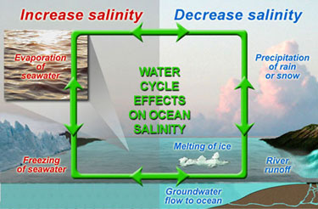
Mission Statement: Provide unprecedented global maps of
Sea Surface Salinity (SSS) to discover how our oceans respond to climate change and impact the water cycle.
Notes:
As you may know, 86% of global evaporation and 78% of global precipitation occur over the oceans. SSS is a key variable in understanding how fresh water input and output affect ocean dynamics and provide a better understanding of ocean-atmosphere interactions linking the water cycle, ocean circulation and climate variability. The Aquarius instrument IS MEASURING this much-needed variable. BEFORE AQUARIUS, we HAD an incomplete story of what’s going on out there in the oceans in terms of SSS.

Slide 4
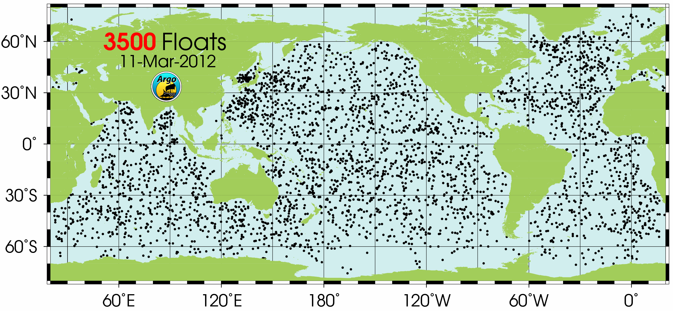
Notes:
Right now, there are OVER 3500 ARGO floats bopping around out there in the ocean collecting temp, salinity and velocity data on the upper 2000m of the ocean. What do we get from this coverage?

Slide 5
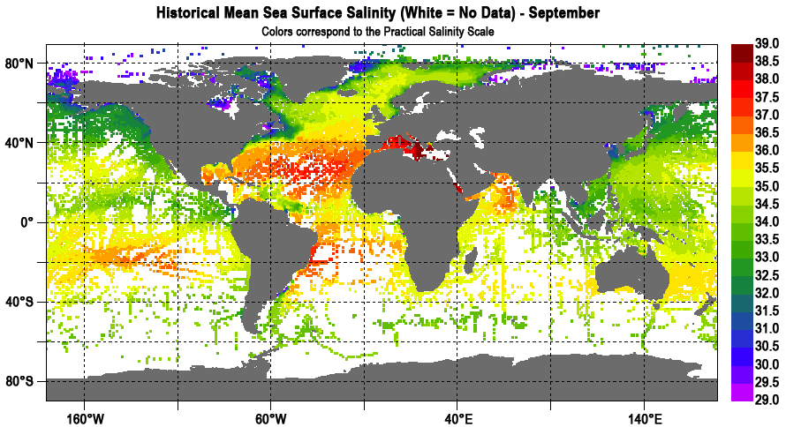
Notes:
We get a map that looks something like this…This is the current coverage of SSS FOR A TYPICAL MONTH OF SEPTEMBER BASED ON 100 years of data USING DATA FROM SHIPS AND in-water ARGO floats…it allows us to guess at some of the patterns, but the data is pretty sparse, ESPECIALLY IN THE SOUTHERN OCEANS. Now, with Aquarius up there…

Slide 6
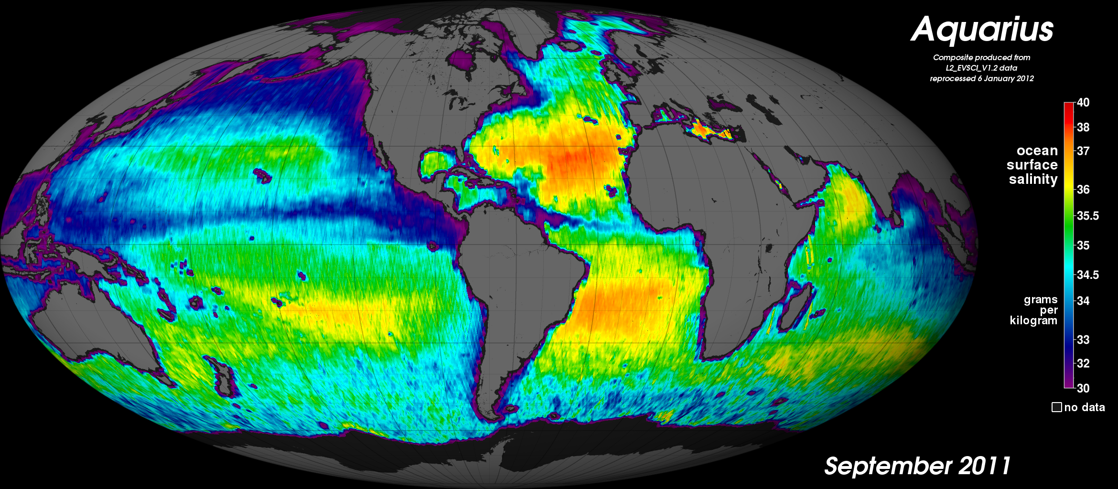
Notes:
…this is what we have from just one MONTH of Aquarius data. Very large difference and we can really get a feeling for global SSS. By tracking SSS over time, we can directly monitor variations in the water cycle, including runoff, sea ice freezing and melting, and the evaporation and precipitation over the oceans to create models for climate predictions.

Slide 7
S T E M
Science Connections

Slide 8
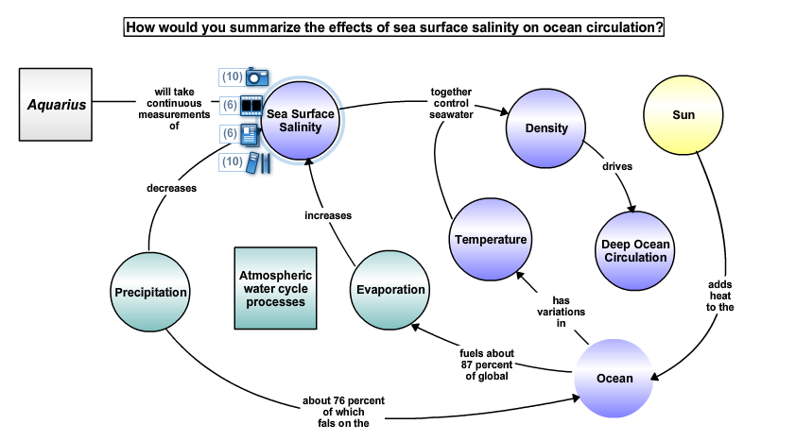
Notes:
You scroll put your cursor on that concept and it tells you what’s available in the form of assets for additional resources. In this case, we have 10 figures, 6 movies, 3 publications and 10 links to additional teaching tools and resources talking about SSS and its interactions. So, let’s find out a bit about salinity…who knows what the definition of salinity is? (It’s the mass ratio of dissolved salts in sea water…how much salt is dissolved in a given volume of sea water) Or what the average salinity in the ocean is? (IT'S 35 AND GENERALLY RANGES BETWEEN 32 AND 37.)

Slide 9
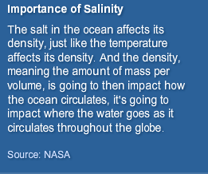
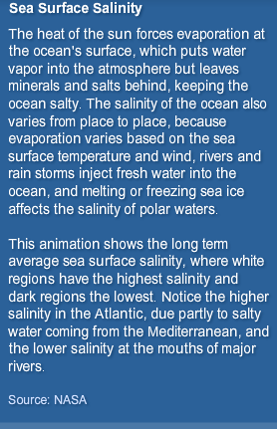
Notes:
Because it plays a large role in earth processes such as the water cycle and climate. Why does salinity play this role…what are some characteristics of salinity that might make it important? SUSAN LOZIER, PROFESSOR OF OCEANOGRAPHY AT DUKE UNIVERSITY mentioned density…what does that mean? (BY THE WAY, DR. LOZIER WILL GIVE A WEBINAR ON TEACHING WITH AQUARIUS DATA IN EARLY MAY... VISIT THE COSEE OR AQUARIUS WEBSITE LATER FOR DETAILS- please sign up on the sheet for e-alerts for the webinars.)

Slide 10
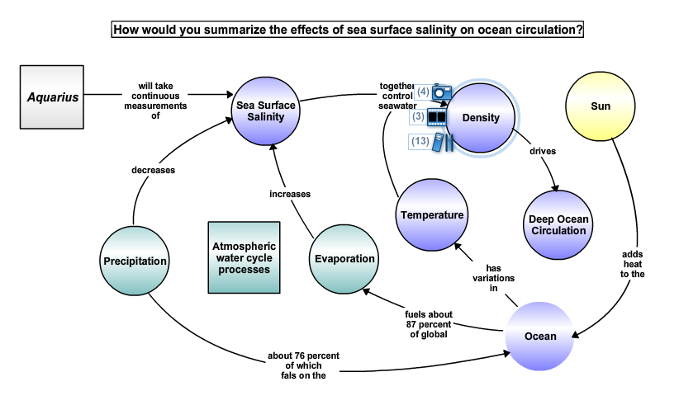
Notes:
Let’s talk about density for a minute then, because it obviously is influenced by salinity and has an important role to play in OCEAN CIRCULATION, PARTICULARLY BELOW WIND-DRIVEN SURFACE CURRENTS. To illustrate this concept, we’re going to do a little demonstration…

Slide 11
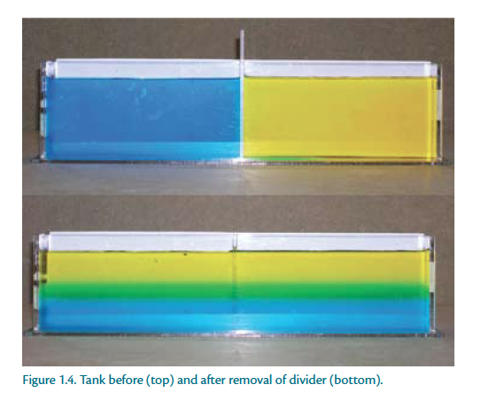
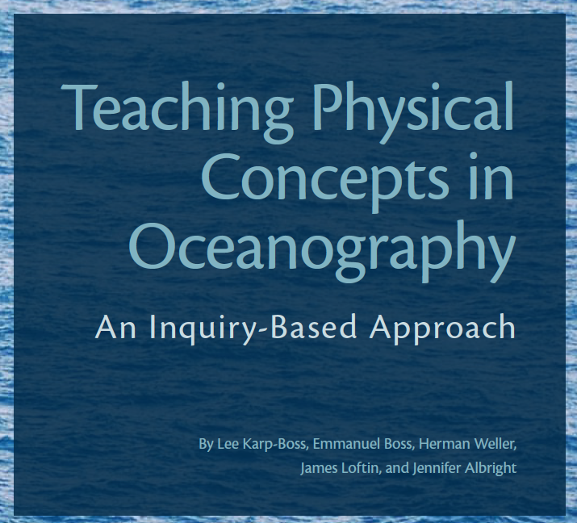
Hands-On Activity: Effects of Temperature and Salinity on Density
Available for download (free)
online – see “Hands-On Activities”
section of the Aq Resources Pg.
Notes:
Effects of Temperature and Salinity on Density
This activity came from the COSEE-OS publication Teaching Physical Concepts in Oceanography, which was written by UMaine scientists IN COLLABORATION WITH A PROFESSOR OF EDUCATION (Dr. Herman Weller) and has activities illustrating other ocean science concepts such as pressure, buoyancy, internal waves, etc. …
So why are these changes in density so important?
Activities like this are great for allowing students to make predictions, test hypothesis, etc. So…what do you all think is going to happen?
Predictions about what will happen when the divider is removed.
Predictions of density and temp distribution in world oceans…seasonality, patterns, conveyor belt ,etc.
Discussions about energy required for mixing (more mixing = more energy).
Predictions about areas of the ocean that would be well-mixed versus stratified.
Activity Video

Slide 12
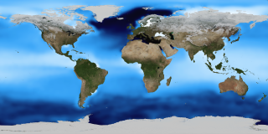
Average Sea Surface Density
The Thermohaline Circulation:
The Great Ocean Conveyor Belt
Notes:
The Thermohaline Circulation - The Great Ocean Conveyor Belt
This animation first depicts thermohaline surface flows over surface density, and illustrates the sinking of water in the dense ocean near Iceland and Greenland. The surface of the ocean then fades away and the animation pulls back to show the global thermohaline circulation.
The oceans are mostly composed of warm salty water near the surface over cold, less salty water in the ocean depths. These two regions don't mix except in certain special areas. The ocean currents, the movement of the ocean in the surface layer, are driven mostly by the wind. In certain areas near the polar oceans, the colder surface water also gets saltier due to evaporation or sea ice formation. In these regions, the surface water becomes dense enough to sink to the ocean depths. This pumping of surface water into the deep ocean forces the deep water to move horizontally until it can find an area on the world where it can rise back to the surface and close the current loop. This usually occurs in the equatorial ocean, mostly in the Pacific and Indian Oceans. This very large, slow current is called the thermohaline circulation because it is caused by temperature and salinity (haline) variations.This animation shows one of the major regions where this pumping occurs, the North Atlantic Ocean around Greenland, Iceland, and the North Sea. The surface ocean current brings new water to this region from the South Atlantic via the Gulf Stream and the water returns to the South Atlantic via the North Atlantic Deep Water current. The continual influx of warm water into the North Atlantic polar ocean keeps the regions around Iceland and southern Greenland mostly free of sea ice year round.The animation also shows another feature of the global ocean circulation: the Antarctic Circumpolar Current. The region around latitude 60 south is the the only part of the Earth where the ocean can flow all the way around the world with no land in the way. As a result, both the surface and deep waters flow from west to east around Antarctica. This circumpolar motion links the world's oceans and allows the deep water circulation from the Atlantic to rise in the Indian and Pacific Oceans and the surface circulation to close with the northward flow in the Atlantic.The color on the world's ocean's at the beginning of this animation represents surface water density, with dark regions being most dense and light regions being least dense (see the animation Sea Surface Temperature, Salinity and Density). The depths of the oceans are highly exaggerated to better illustrate the differences between the surface flows and deep water flows. The actual flows in this model are based on current theories of the thermohaline circulation rather than actual data. The thermohaline circulation is a very slow moving current that can be difficult to distinguish from general ocean circulation. Therefore, it is difficult to measure or simulate.

Slide 13
Notes:
This is a movie showing 4 months worth of Aquarius Global Salinity data (Sept, Oct, Nov, and Dec 2011) Red colors indicate high salinity, and blue colors indicate lower salinities. Notice how the Atlantic Ocean is much more salty than the Pacific Ocean. First we will show a globe view, and then zoom into the Atlantic Ocean view. In the Atlantic Ocean over these 4 months, you can see changes in the fresh water outflow of the Amazon and Orinoco Rivers into the Atlantic (blue swirls off the coast of South America) –which haven’t been seen in this detail before!

Slide 14
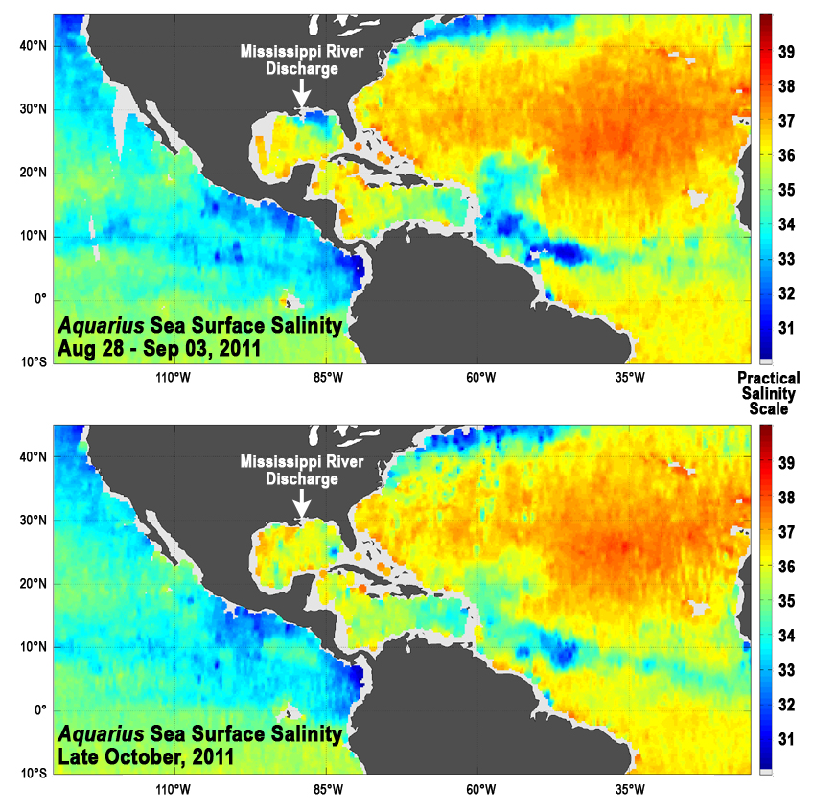
Notes:
What’s happening in these slides? Anyone care to guess…think about what’s happening with weather at this point in time. Why do we see the freshening of the Gulf of Mexico at this time? This is slide shows the difference in salinity at the outflow of the MI River during Tropical Storm Lee in September 2011 and during October 2011. Decreased salinity is most likely the effect of increased river discharge and heavy rainfall during the storm.

Slide 15
filex://localhost/Users/cherren/Documents/COSEE/Conferences/NSTA/NSTA_2012_Indianapolis/Presentation_ aq_nsta10/Aquarius_Globe_Final/index.html

Slide 16
S T E M
Technology Connections

Slide 17
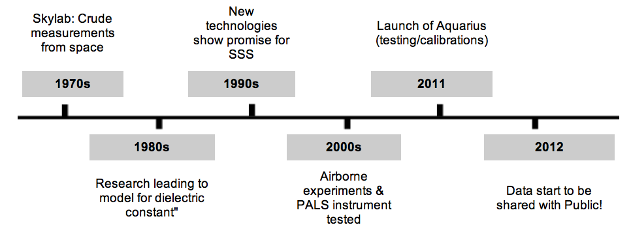
Aquarius History:
A Very Long Process of Testing, Designing and Redesigning
Notes:
Getting to this point has been a very long process. Aquarius is a great example of the scientific process who’s history spans 4 decades, illustrating the scientific method from start to finish. For example, it all started in the 70’s with crude SSS measurements from space via Skylab. In the 80’s, thorough experimentation and technological advances led to the development of A MODEL OF THE “dielectric constant” FOR SEAWATER, WHICH TELLS US ABOUT ITS CONDUCTIVITY THAT IS, IN TURN, RELATED TO ITS SALINITY. Similarly, technology continued to develop, allowing for confidence in remote salinity measurements. The 2000’s were characterized by lots of hypothesis testing via experiments and the development of a new instrument to measure salinity, PALS. The satellite, in partnership with THE SPACE AGENCY OF ARGENTINA, was launched from Vandenberg AFB California in June 2011.

Slide 18
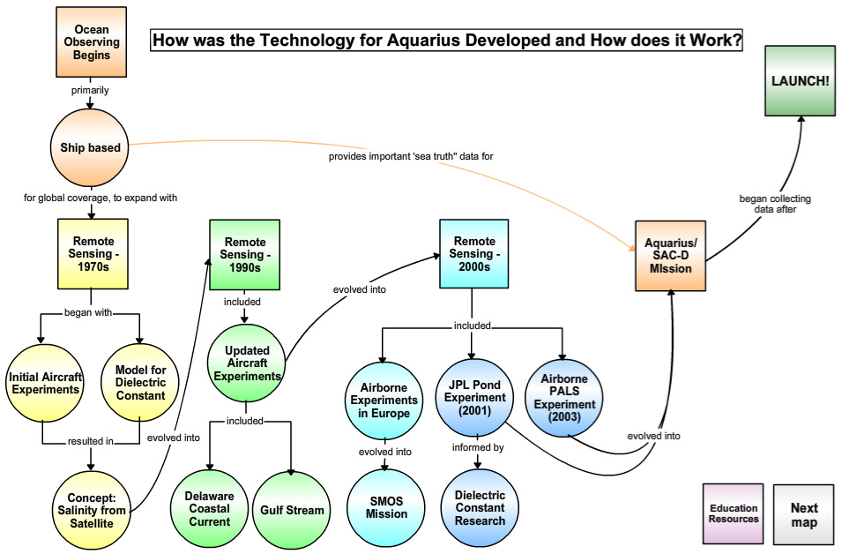
Notes:
Let’s check out some of the technology and engineering making this whole mission possible. This is where Aquarius can play a great role in incorporating Technology and Engineering into a curriculum. It illustrates the importance of the scientific process in the development phase of such technology and the engineering design that makes it possible to put such technology in space. Does anyone know how we measure salinity if we were to head out to the ocean on a boat?
In the third webinar, we see the actual results of the Aquarius satellite and discuss the use of the data and the shortcomings of the instrument, leading to a discussion of the scientific process itself and the importance of replication over temporal and spatial scales and the continued questioning and recalibration of the technology design.
So,
So, I see a lot of the words Remote sensing…what does that mean (the observation of an object without physically touching the object (eg. Weather maps)). So, the scientists had to come up with a technology that could measure salinity without touching ocean water. So, they needed to use different variables and a different instrument called a radiometer.

Slide 19
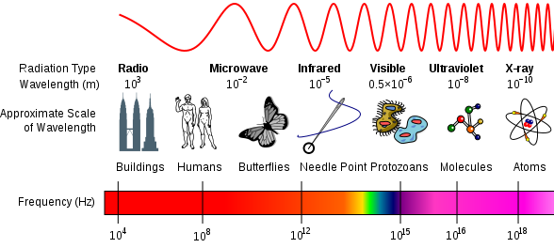
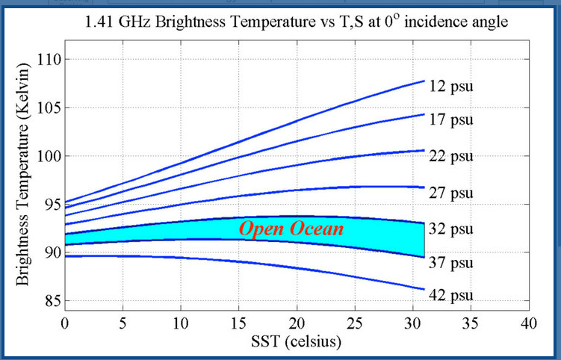
Scientists figured out that Sea Surface Salinity (SSS) can be measured by analyzing Microwave Radiation signals from the ocean surface (e.g., brightness temperature) with a sensor called a Radiometer.
SSS as a function of Sea Surface Temperature
and Brightness Temperature
(microwave emissions from ocean surface
Notes:
A radiometer measures the emission of microwave frequencies from the ocean surface, a measurement called brightness temperature. If you know the brightness temperature and the Sea Surface Temp, then you can figure out salinity. This shows the average psu (practical salinity unit) for open ocean (from the coastline to the marginal seas) to be 32-37 psu. Because of such differences, this instrument needed to be precise.

Slide 21
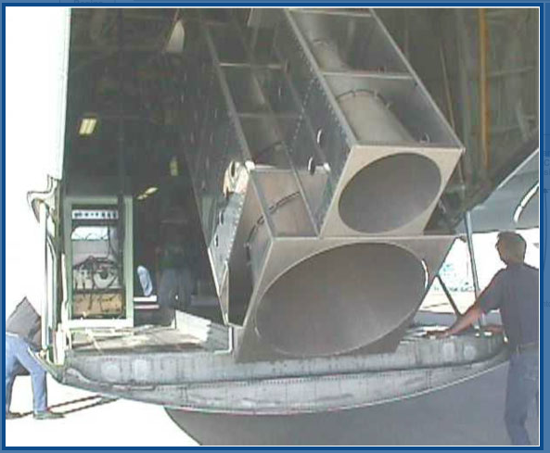
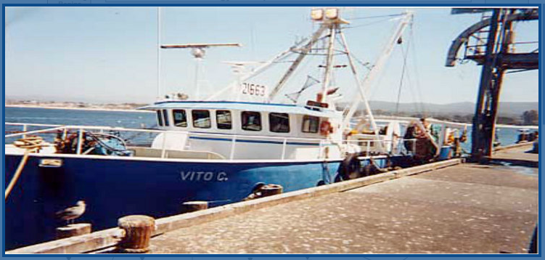
Notes:
So, basically for the next 30 years, there was a lot of testing and experimentation with this radiometer instrument. In the 2000’s, they began to get very close. In 2001, they made a prototype of the developed Aquarius instrument, created a man-made pond AT THE NASA JET PROPULSION LABORATORY to be able to test its ability to detect changes in salinity and calibrated the instrument for calm seas. Remember how I said that the instrument needed to be precise…anyone want to guess how precise? 0.2psu (parts per thousand). How much salt would I have to put in a gallon of fresh water to change it’s salinity by 0.2 psu? 1/8 of a teaspoon.
While other scientists ground-truthed it with CONDUCTIVITY-TEMPERATURE-DENSITY SENSORS CTD’s) on a boat… FOR IN-WATER SENSORS, CONDUCTIVITY IS USED TO MEASURE SALINITY. And they got these results!! So, after all this time, experimentation and improvements to the radiometer. It was ready to go…but then they had WORK CLOSELY WITH ARGENTINA TO MAKE SURE THE OBSERVATORY WAS stable enough to take this delicate instrument into space…

Slide 22
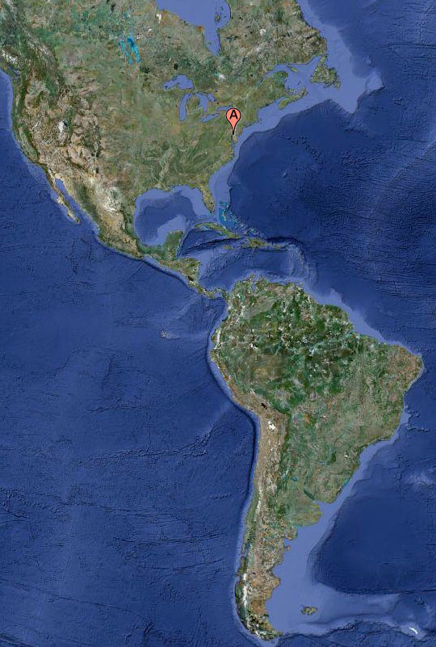
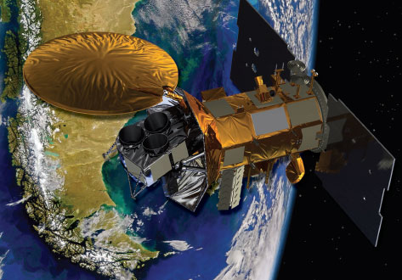
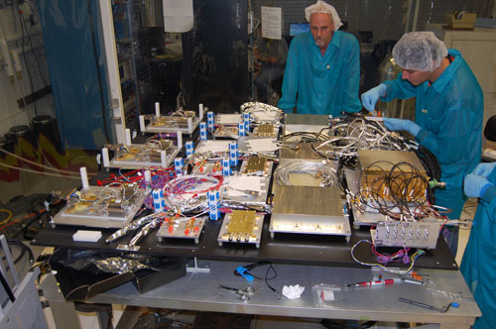
NASA Goddard Space Flight Center
Aquarius radiometer construction

Slide 23
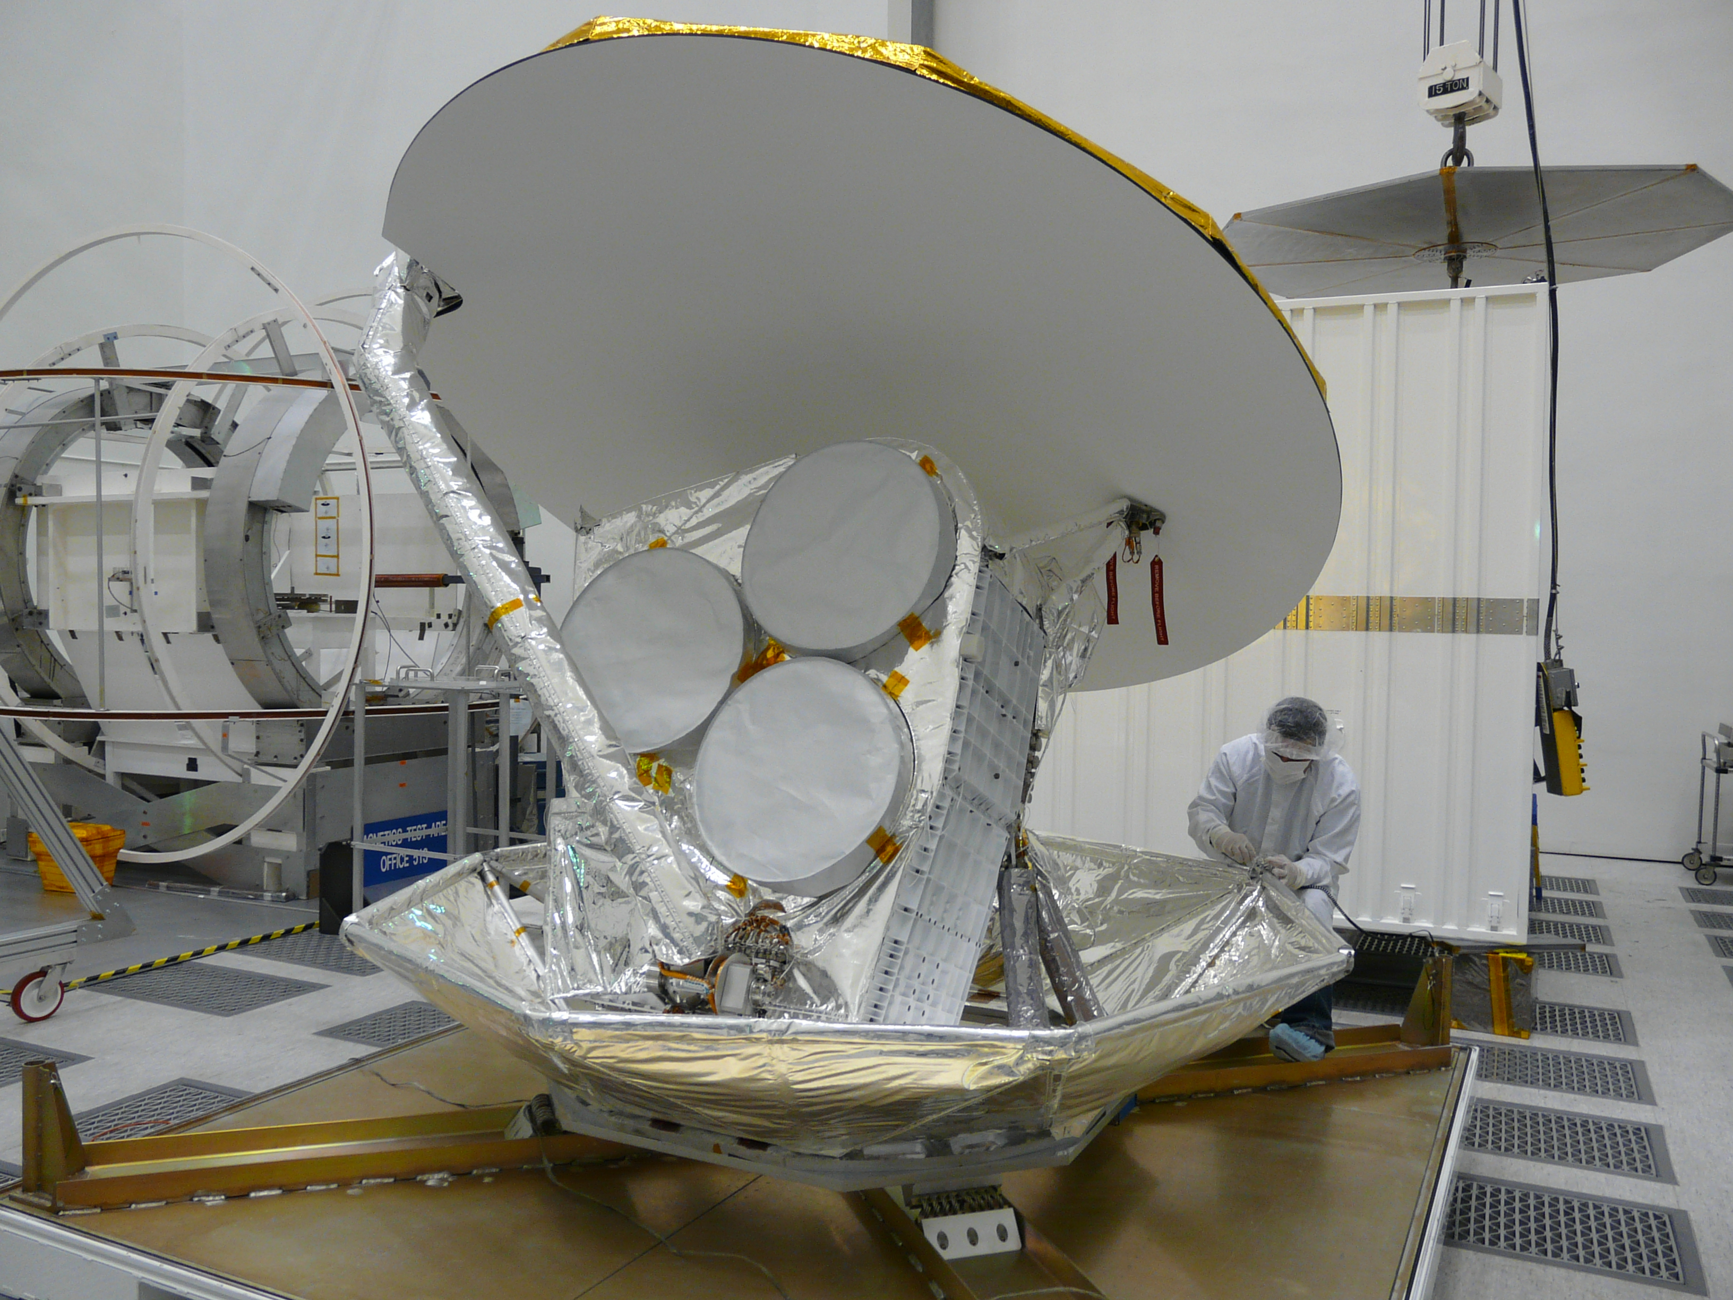
NASA Jet Propulsion Laboratory
Aquarius full instrument assembly & testing

Slide 24
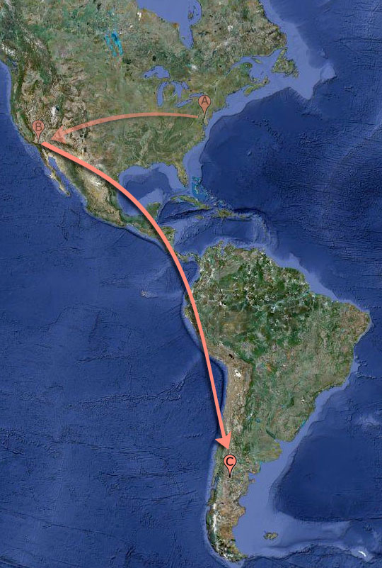
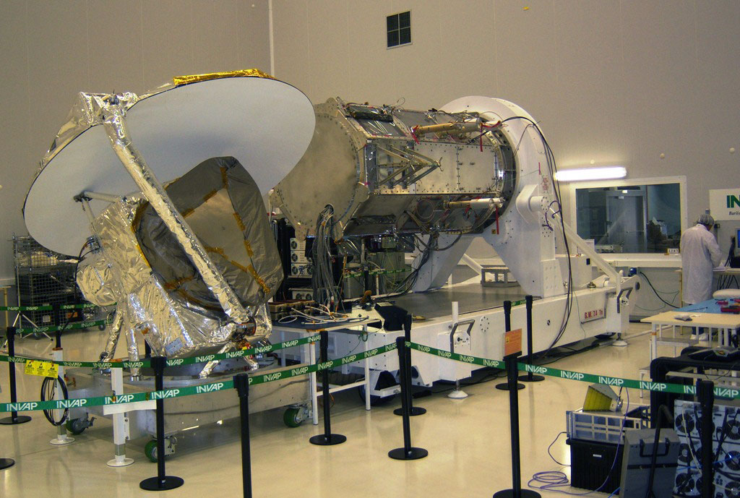
INVAP at Bariloche, Argentina
Aquarius / SAC-D satellite assembly & testing

Slide 25
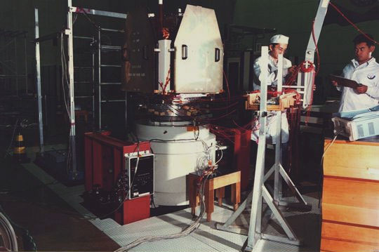
Brazil’s National Institute for Space Research (INPE)
Aquarius / SAC-D final integration & testing

Slide 26
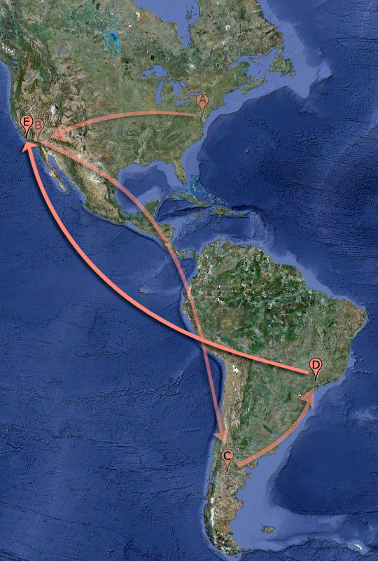
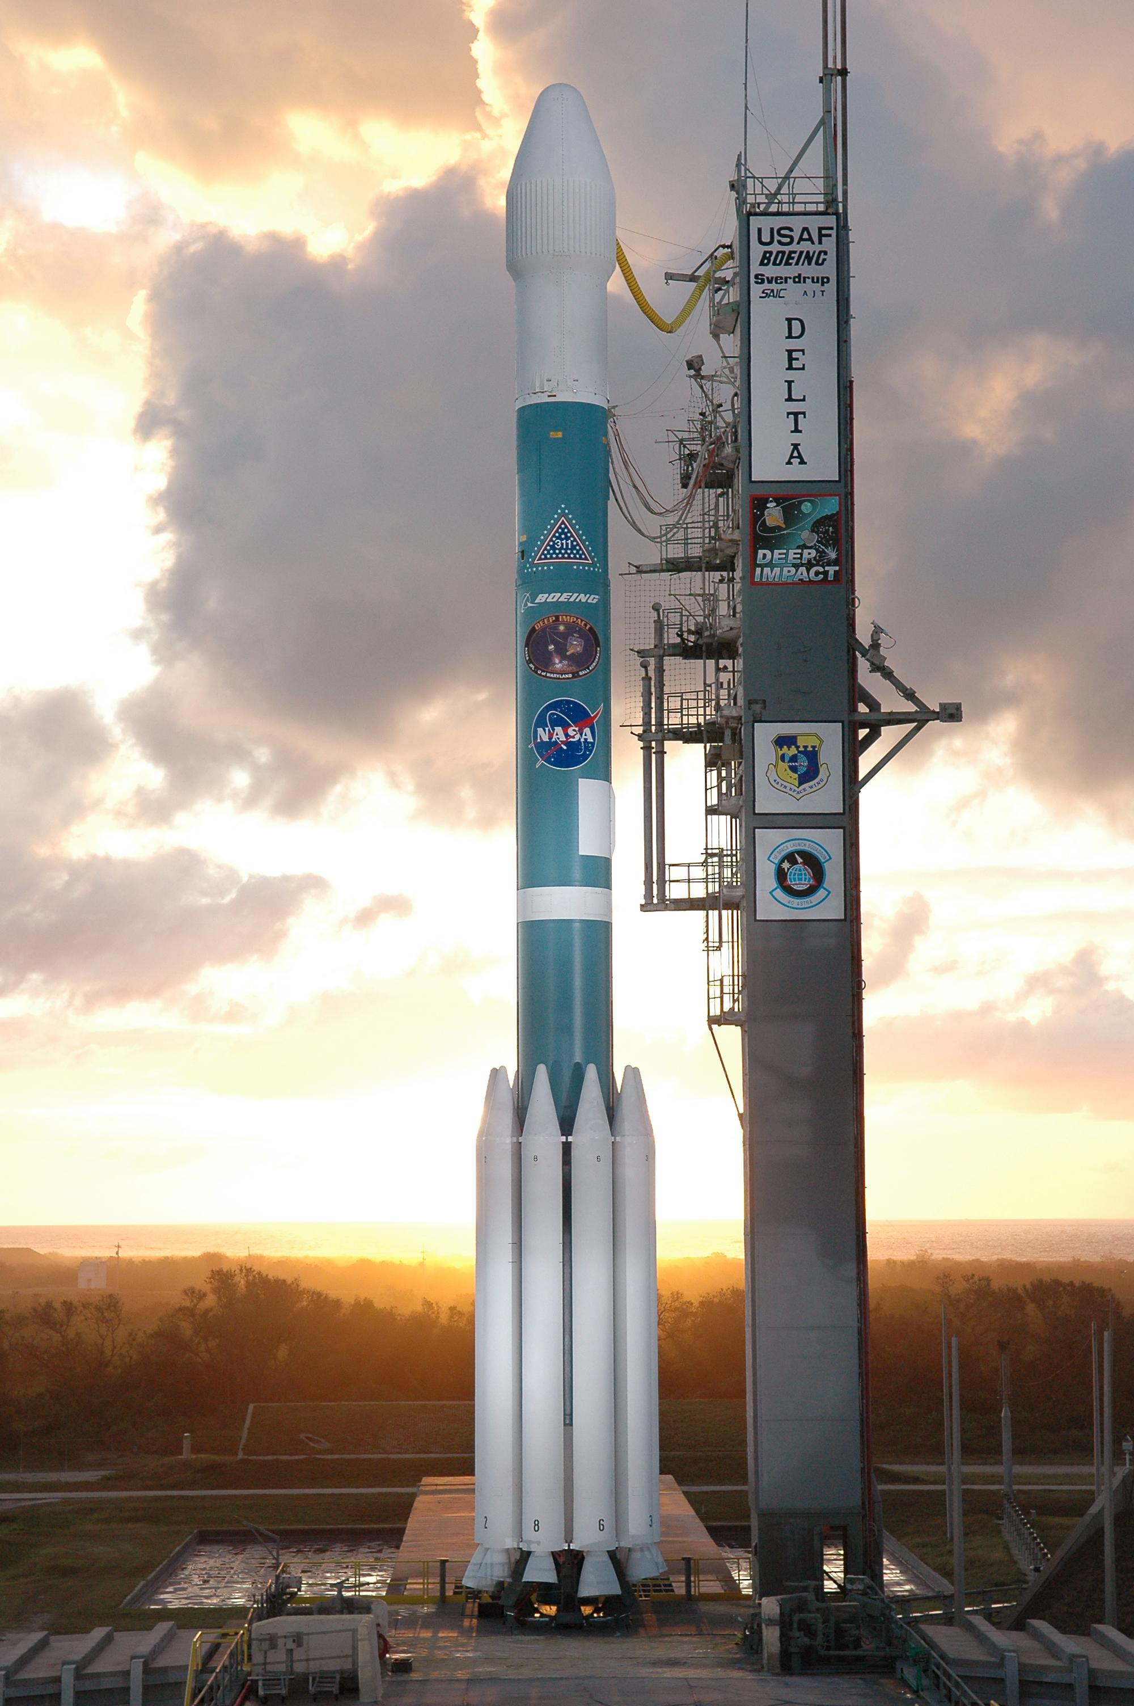
Vandenberg Air Force Base
Aquarius / SAC-D launch on Delta II rocket
Notes:
So…launched in June 2011…data was beginning to come in by September 2011…

Slide 27
S T E M
Engineering & Math
Connections

Slide 28
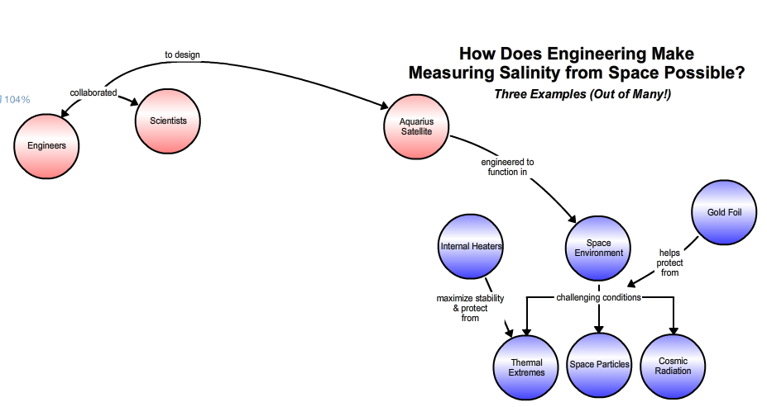

Slide 29
Speaking: Gary Lagerloef
Aquarius Principal Investigator
Earth and Space Research, Seattle, WA
Notes:
How does engineering make measuring salinity from space possible? Scientists and Engineers (aerospace, mechanical, electrical, others!) spent untold hours collaborating to get all the parameters “just right” for the sensors and the payload on the Aquarius satellite to work properly in the space environment. What do you think are some of the “challenges” in the space environment?
2 Examples of Engineering Connections:
(1) Gold Foil (Gary talks about this in the video clip)
(2) Thermal Control: Internal Heaters (AdC mentioned: Aquarius radiometers are the MOST SENSITIVE ever built for this frequency (L-band, 1.413 GHz) and the temperature of the radiometers themselves have to be very stable (so these heaters are used to keep the temperature of the radiometers themselves constant).

Slide 30
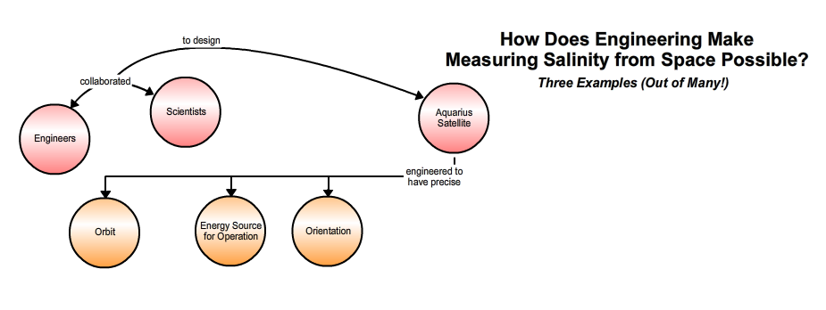

Slide 31
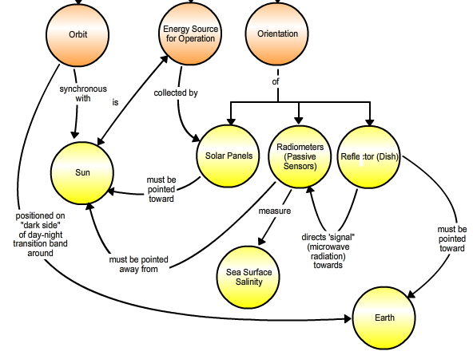
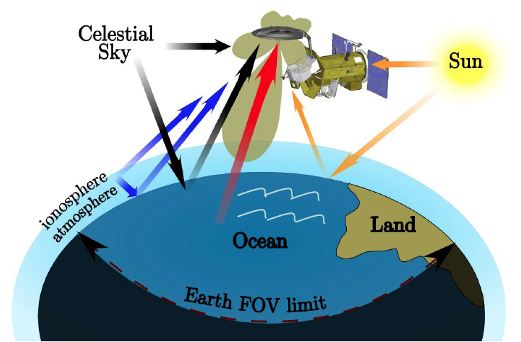
Speaking: David Le Vine
Aquarius Deputy Principal Investigator
NASA/Goddard Space Flight Center, Greenbelt, MD
Notes:
How does engineering make measuring salinity from space possible? Scientists and Engineers (aerospace, mechanical, electrical, others!) spent untold hours collaborating to get all the parameters “just right” for the sensors and the payload on the Aquarius satellite to work properly in the space environment. What do you think are some of the “challenges” in the space environment?
Some Examples of Engineering Connections:
Orbit
Orientation in Space (relative to Sun and Earth)
Energy Source for Operation (Sun)

Slide 32
S T E M
Educational Resources
Notes:
ACCESSING The AQ TEACHING TOOLS, DATA SETS, RESOURCES
SO IN JUST A FEW MONTHS of the Launch (June 2011), SCIENTISTS ARE STARTING TO BENEFIT FROM THIS NEW STREAM OF DATA. BUT NOT ONLY SCIENTISTS ARE REAPING BENEFITS FROM AQUARIUS....

Slide 33
A Wealth of Educational Resources for You and your Students!
Including the concept maps we showed!
Notes:
Educational Videos & Visualizations: View videos that showcase Aquarius data, the science behind studying the salinity of the ocean, and how Aquarius is able to measure salinity across the globe, as well as animations describing ocean circulation, the water cycle and climate processes as they relate to ocean salinity. Great for the classroom!
Webinars: Scientists Discuss How Aquarius Studies our Salty Seas (Including the concept maps we showed!)
View Aquarius webinars featuring NASA scientists and a wealth of educational resources.
(remember we saw/heard clips from videos given by Gary Lagerloff and David Le Vine (JPL) in engineering section)
Note: What does the Data Tell us? see the actual results of the Aquarius satellite and discuss the use of the data and the shortcomings of the instrument, leading to a discussion of the scientific process itself and the importance of replication over temporal and spatial scales and the continued questioning and recalibration of the technology design.
NASA Scientist Interviews and Launch Status Updates
Check in on the excitement leading up to he launch of the SAC-D satellite.

Slide 34
A Wealth of Educational Resources for You and your Students!
Great way for students
to practice math/graphing skills
Notes:
"Hands On" Activities
Download tested lesson plans that help students learn the fundamental concepts of salinity, density, circulation and climate.
Interactive Data Tools
Explore World Ocean Atlas salinity, temperature and density data in Google Earth and flat map interfaces.
Aquarius/SAC-D Lithograph, Mission Poster, Brochure and more!
Learn mission details, history and the science behind the satellite.

Slide 35
A Wealth of Educational Resources for You and your Students!
Notes:
Salinity?
There’s an app for that!
View news, images, and animations from Aquarius and hold the mission in the palm of your hand.
Go With The Flow (Online Game)
Test your knowledge of salinity and density with this challenge-based game. Steer your sub to sunken treasure using tools to change the currents using salt and heat.
More resources online at http://aquarius.nasa.gov
Have a smart phone? Scan the code to the right to go straight to Aquarius resources

Slide 36
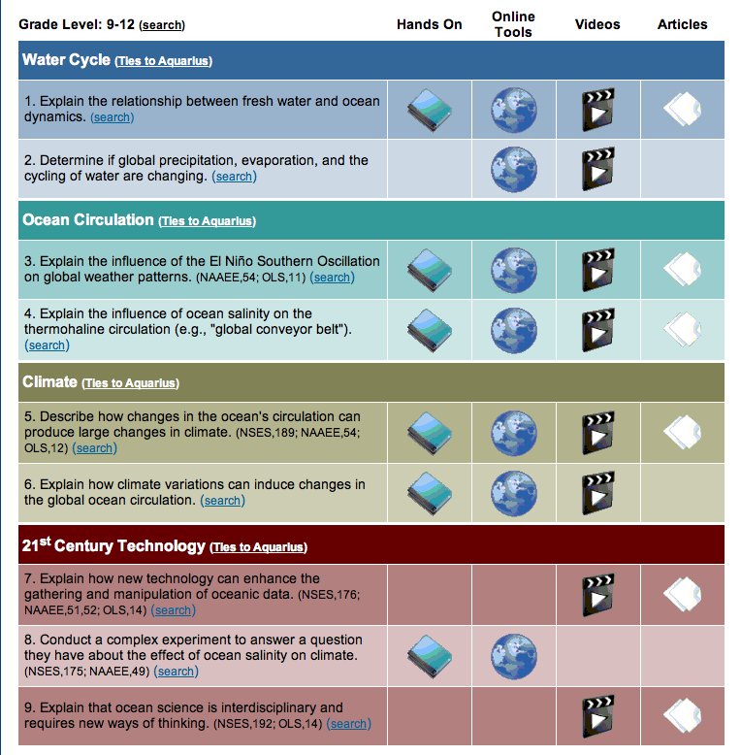
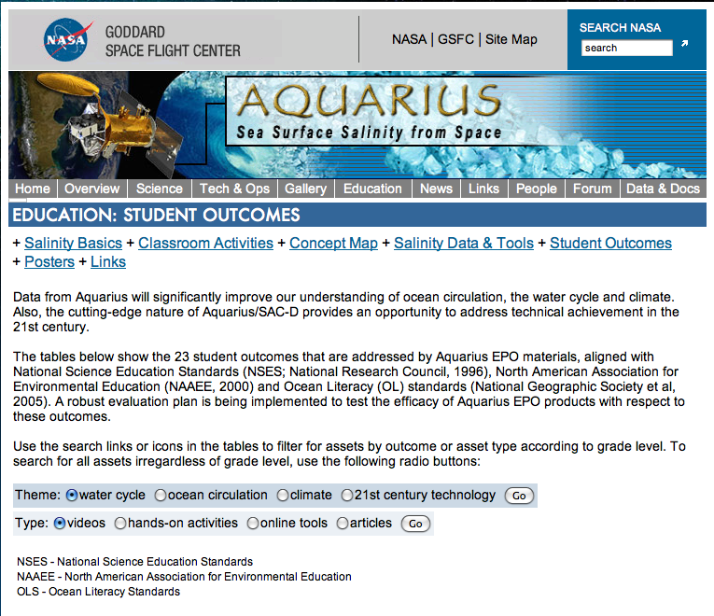
Searchable database: Theme, resource type & grade levels Aquarius Home
Notes:
A great way to get started exploring all that salinity and Aquarius have to offer in a classroom is by checking out the searchable database on the Aquarius website. Once at the website, you can either search for teaching tools by identifying a theme or type of tool you would like to use, or just scroll down to see lists of resources according to grade level grouping. Beside each of these headings, there is a link to explain the ties to Aquarius to help you to better understand and make connections between Aquarius and these concepts. In addition, there is also information about how each section addresses national science standards and ocean literacy standards.

Slide 37
Hot off the Programmer’s Computer: Aquarius Interactive Globe!
http://cosee.umaine.edu/coseeos/aquarius/aquarius_globe_index_html/index_5secwait.html
Notes:
Aquarius Globe Interactive

